Slide 1
How did the establishment of the University of Georgia, Louisville, and the spread of Baptist and Methodist churches affect the development of Georgia?
Standard: SS8H5a. Explain the establishment of the University of Georgia, Louisville, and the spread of Baptist and Methodist churches.

Slide 2
Think, Pair, Share
Describe how each of the factors below could symbolize the development or growth of Georgia?
The establishment of the University of Georgia
The change in location of the state’s capital
The spread of Baptist and Methodist churches

Slide 3
Use your graphic organizer to summarize the important information from the lesson.

Slide 4
Growth of Georgia: University of Georgia

Slide 5
University of Georgia
On January 27, 1785, the University of Georgia was officially established when Georgia’s General Assembly approved a charter written by Abraham Baldwin.
In the charter, it said that education was for everyone, not just the wealthy! (That was radical thinking in 1785!)

Slide 6
University of Georgia
When the charter was signed in 1785, it became the first publically supported institute of higher learning.
The actual building of the school did not begin until 1801 and classes did not begin until September of 1801

Slide 7
University of Georgia
Although UGA was the first public university to be chartered, the University of North Carolina was the first to hold classes, creating a spirited debate as to which school is actually the Nation’s first state sponsored university.

Slide 8
Growth of Georgia: Capital City Changes

Slide 9
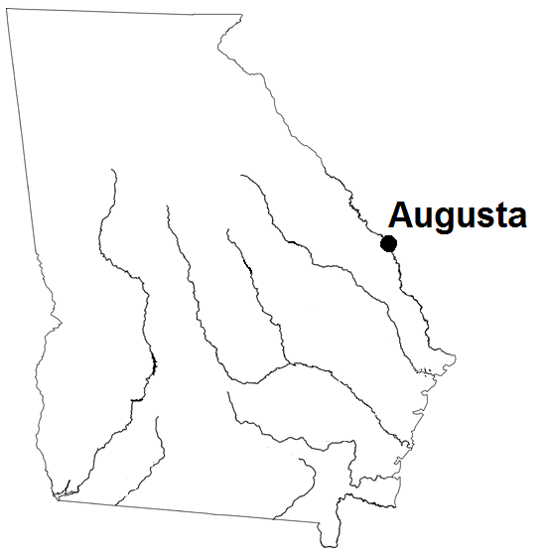
In 1785, the state capital moved to Augusta, but a search for a new more centrally located capital was initiated.
Why would they search for a more centrally located capital?

Slide 10
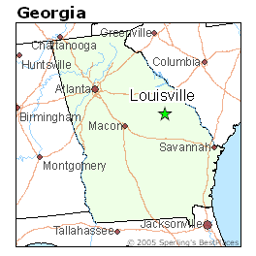
Louisville (“Lewis”ville)
In 1796, Louisville became Georgia’s third state capital
It was selected as the capital due to, what at the time was its location as the center of Georgia population (driven by westward expansion)
State legislators hoped that the town would also serve as a trading center due to its location on the Ogeechee River

Slide 11
Louisville
Louisville developed both socially and financially
Its time as capital ended in 1807 due to…
malaria outbreaks that occurred in the city every year
difficulty of using the Ogeechee River for trade
most importantly, continued Northwestern movement of Georgia’s population

Slide 12
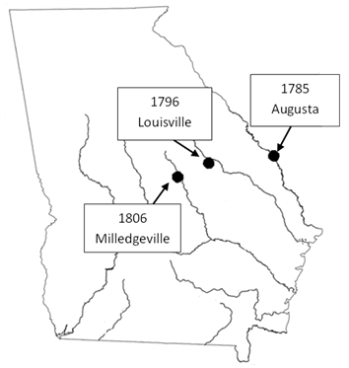

Slide 13
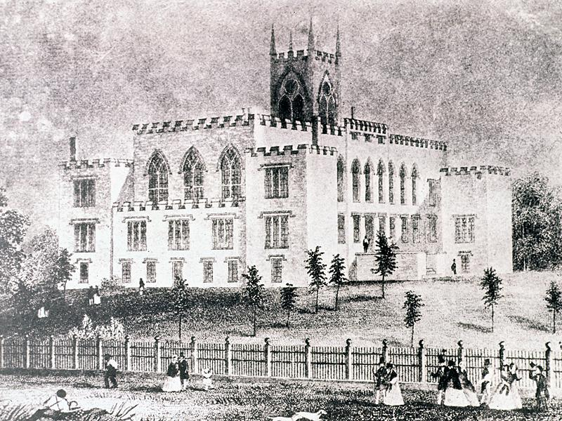
The Capitals of Georgia
Savannah
Augusta
Louisville
Milledgeville
Atlanta

Slide 14
Growth of Georgia: Baptist and Methodist Churches

Slide 15
The Anglican Church as the official church of England and the king was its recognized head.
What did independence from Great Britain now mean for many U.S. citizens?
Many U.S. citizens now stood separated from the only church they’d ever known

Slide 16
Some citizens started setting up American versions of the Anglican Church, while others sought new churches.
Two religious groups that impacted Georgia the most during this time period were the Baptist and Methodist.

Slide 17
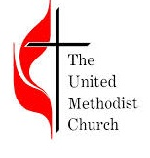
Baptist and Methodist Churches Grow
Both churches gained popularity amongst working class Georgians in the frontier and small towns of the state
They both grew because of their willingness to use new methods to reach people along the frontier
Revivals
Camp meetings
Circuit riders (ministers who rode from town to town)
Due to mission work on plantations, many slaves converted to either the Baptist or Methodist churches

Slide 18
3 – 2 - 1
Identify 3 developments in Georgia during the period after the American Revolution
Identify 2 ways in which these developments impacted Georgia or its people
Identify the 1 development you feel had the most impact on Georgians. Explain why.

