Slide 1
Georgia Studies:
RECONSTRUCTION
PERIOD
© Brain Wrinkles

Slide 2
Reconstruction
Reconstruction means to build something again.
It is the name given to the time period after the Civil War, from 1867 to 1877.
During Reconstruction, Georgia and other Southern states needed to be rebuilt and brought back into the Union.
© Brain Wrinkles

Slide 3
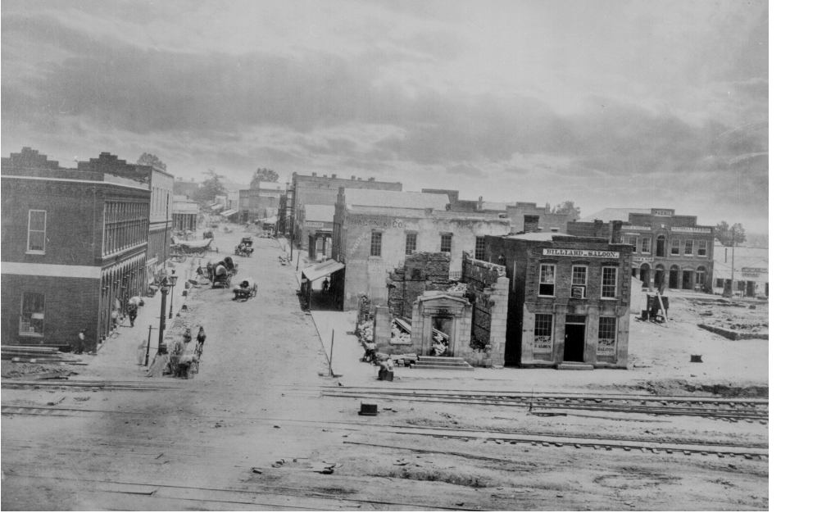
Ruins on Peachtree Street
Atlanta 1864
© Brain Wrinkles

Slide 4
Georgia
1865 was a tough year across the South, particularly in Georgia.
The state’s government had collapsed and the governor was imprisoned in Washington D.C.
Confederate soldiers returned from the war to find their plantations and farms destroyed and barren.
Many were hungry, poor, or even homeless.
© Brain Wrinkles

Slide 5
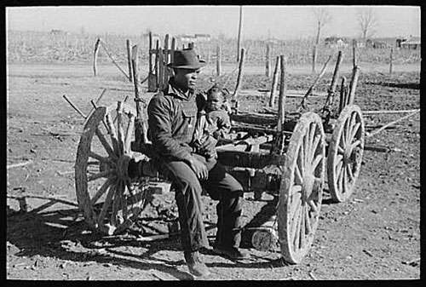
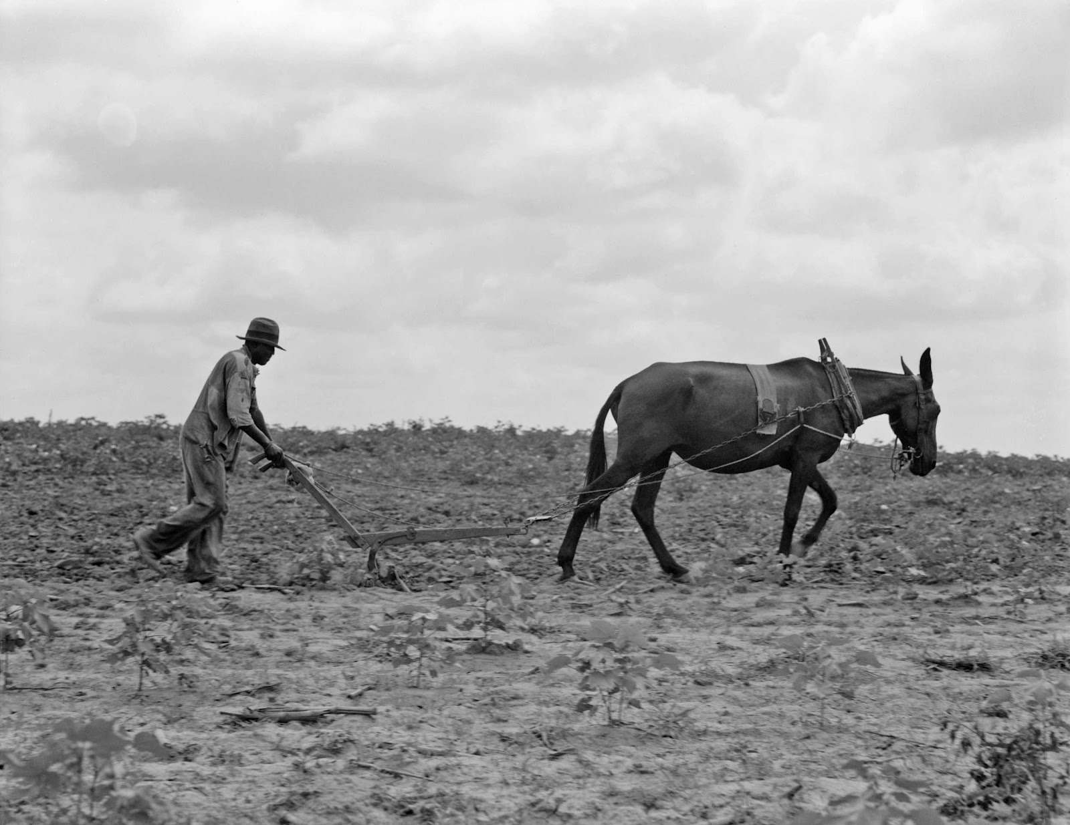
© Brain Wrinkles

Slide 6
Georgia
Recovery was difficult as Georgians lacked the money needed to rebuild the state’s infrastructure (railroads, factories, farms, etc.).
The Civil War had destroyed Georgia’s agricultural economy and Georgians were not sure how to revamp their farms without using free (slave) labor.
© Brain Wrinkles

Slide 7
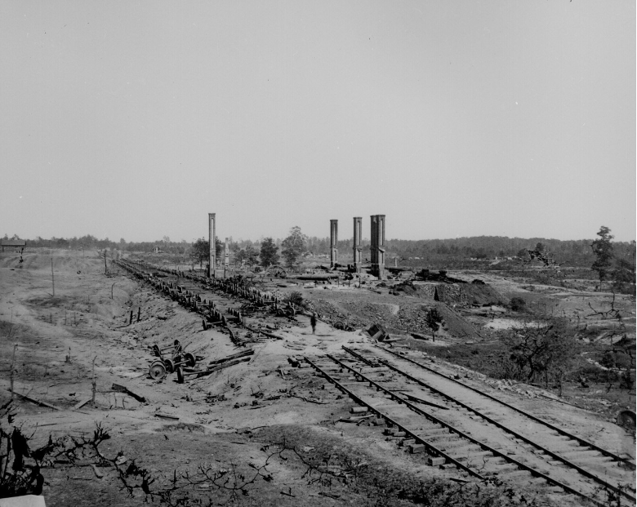
Railroad Lines Ruins that had to be Rebuilt
Atlanta 1864
© Brain Wrinkles

Slide 8
Farming
Freed slaves in Georgia and other Southern states needed to make a living in order to feed their families.
They returned to their old masters and became either sharecroppers or tenant farmers.
Freed slaves knew how to grow crops, and landowners still needed labor.
© Brain Wrinkles

Slide 9
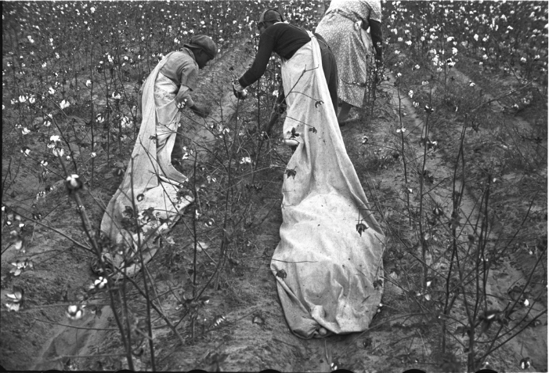
Young Sharecroppers Picking Cotton
© Brain Wrinkles

Slide 10
Sharecropping
In the sharecropping arrangement, the owner would lend the worker a place to live, his seeds, and farm equipment.
Sharecroppers received almost no pay, just a small share of the crops.
© Brain Wrinkles

Slide 11
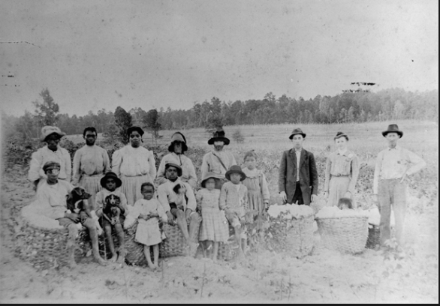
Sharecroppers & Cotton Bales
© Brain Wrinkles

Slide 12
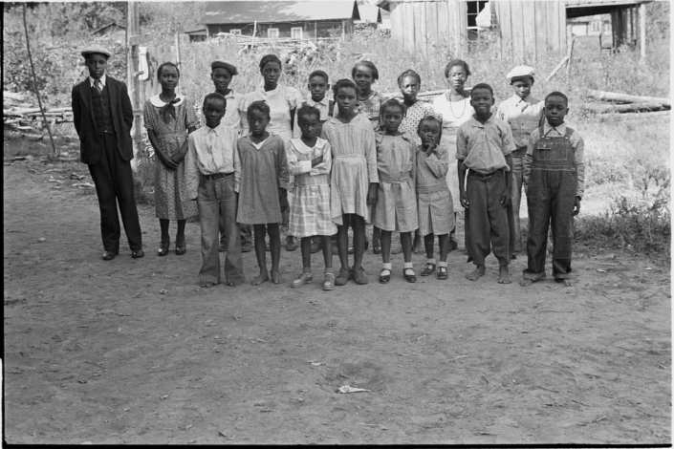
Children of African American Sharecroppers in Arkansas
© Brain Wrinkles

Slide 13
Sharecropping
Because the worker had no money for rent, he would give the owner a share of the crop, plus extra for the cost of rent and supplies.
The workers had little hope of ever owning land because they rarely made a profit.
© Brain Wrinkles

Slide 14
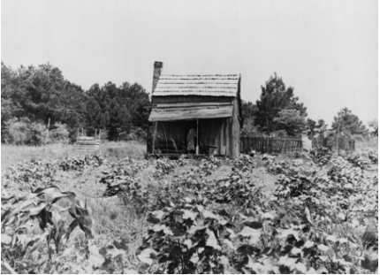
Sharecropper’s Cabin Surrounded by Cotton
© Brain Wrinkles

Slide 15
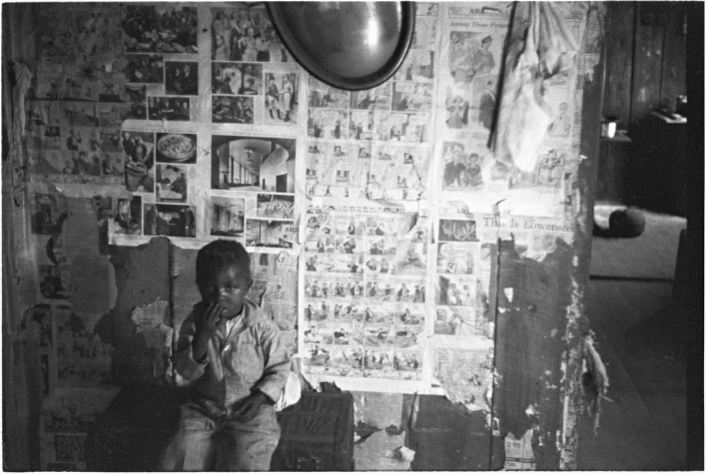
Inside a Sharecropper’s Home
© Brain Wrinkles

Slide 16
Tenant Farmers
Tenant farmers made similar arrangements with landowners where they rented sections of land.
However, unlike sharecroppers, tenant farmers often owned animals, equipment, and supplies, so they received more of the harvest.
© Brain Wrinkles

Slide 17
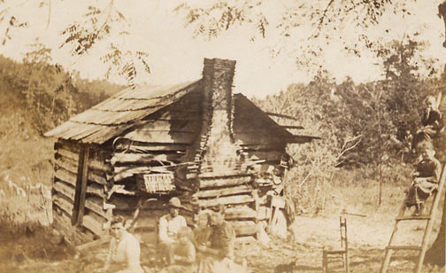
© Brain Wrinkles

Slide 18
Tenant Farmers
Even so, after money was deducted for rent, there was little left over for the farmer.
It was impossible to get ahead as a sharecropper or tenant farmer.
© Brain Wrinkles

Slide 19
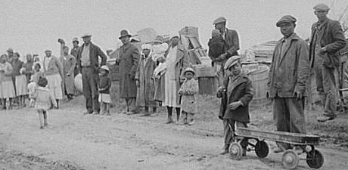
Families of Evicted Sharecroppers in Arkansas
© Brain Wrinkles

Slide 20
Cotton
The Civil War hurt Georgia’s cotton production.
Agriculture experts urged farmers to grow other crops besides cotton, but there was still a huge demand for cotton in the North and Europe.
Georgia farmers worked hard to harvest more cotton since prices were so high.
© Brain Wrinkles

Slide 21
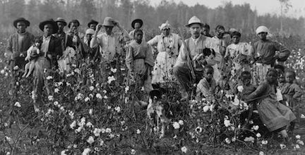
Mississippi Sharecroppers
© Brain Wrinkles

Slide 22
The North
The North’s textile industry heavily depended on cotton produced in the South.
Northerners had a lot to gain by helping the South rebuild its agriculture.
Many Northern investors provided the money to rebuild farms, cotton mills, and railroads across the South in order to quicken the region’s recovery.
© Brain Wrinkles

Slide 23
Freedmen’s
Bureau
Some Northerners came to the South to support the freed black slaves who were uneducated and unemployed.
The U.S. government established the Freedmen’s Bureau in 1865, which gave food, clothing, medicine, and other supplies to freed slaves.
© Brain Wrinkles

Slide 24
Freedmen’s
Bureau
The Freedmen’s Bureau established more than 4,000 schools.
It also helped freed slaves with legal problems.
The bureau also helped poor whites, many of whom lost everything in the war.
© Brain Wrinkles

Slide 25
Education
Georgia had a higher population of freed black slaves (who were uneducated and unemployed) than any other state.
Educating slaves was forbidden in Georgia prior to the Civil War.
The first school for blacks opened in an old Savannah slave mart in 1865.
© Brain Wrinkles

Slide 26
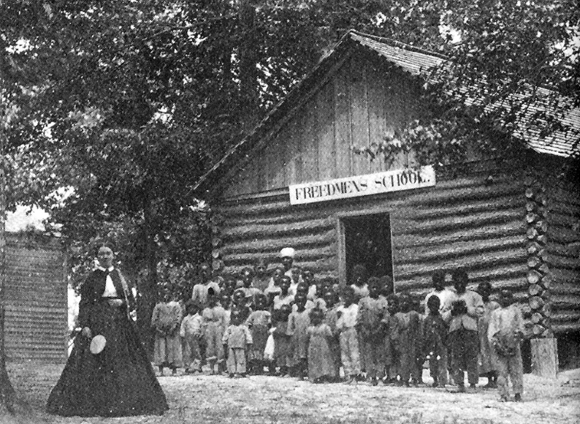
© Brain Wrinkles

Slide 27
Education
The Freedmen’s Bureau created the first public school program for blacks and whites in the state and set the stage for Georgia’s modern public school system.
It established Clarke Atlanta University and Morehouse College.
© Brain Wrinkles

Slide 28
Criticism
Unfortunately, many Georgians did not welcome the work of the Freedmen’s Bureau and criticized the organization for helping blacks.
White Southerners did not want blacks to become educated because they feared educated blacks would want political equality.
They did not want blacks voting in elections.
© Brain Wrinkles

Slide 29
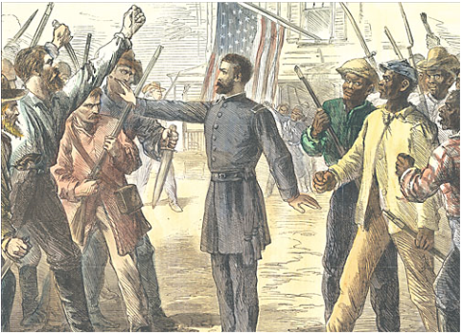
A Freedmen’s Bureau Agent Stands Between Armed Groups of Whites and Freed Men
© Brain Wrinkles

Slide 30
Voters
Many white Southerners believed that the freed slaves were inferior and unable to understand politics.
At this time, there were approximately 700,000 eligible African American voters in the South.
By 1867, about 80% of Georgia’s black adult males became registered voters.
© Brain Wrinkles

Slide 31
Government
For a brief period during Reconstruction, Freedmen were given more political rights than they had ever had (and would not have again for 100 years).
With this freedom, 32 black legislators were elected to the Georgia General Assembly in 1867.
This was a major victory because they could improve the lives of all African Americans in Georgia.
© Brain Wrinkles

Slide 32
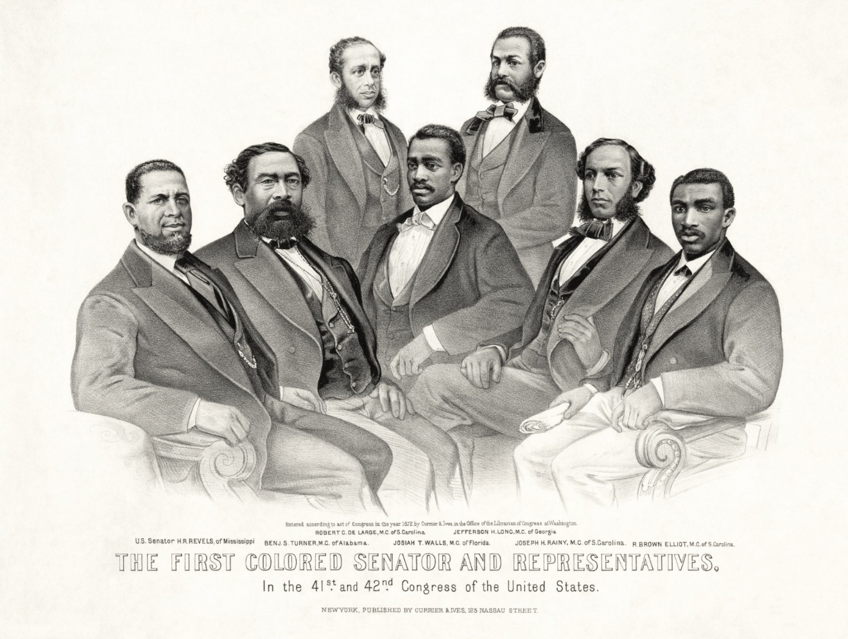
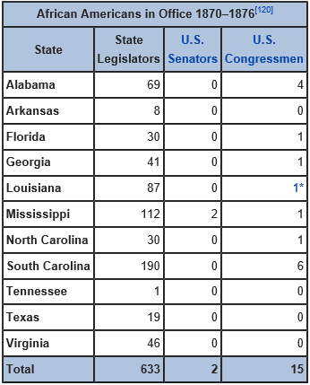
© Brain Wrinkles

Slide 33
Turner
Among the delegates was Henry McNeal Turner, an educated minister who had served as the first black chaplain in the U.S. Army.
Turner was elected to the House of Representatives in the 1968 election for the Georgia Assembly.
© Brain Wrinkles

Slide 34
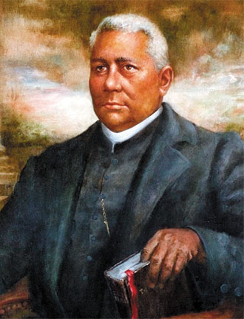
Henry McNeal Turner
© Brain Wrinkles

Slide 35
Objections
Black legislators faced daily harassment from white citizens and politicians.
Over 25% were threatened, beaten, or jailed during their term as legislators.
Many white politicians protested that Georgia’s Constitution denied blacks the right to hold political office.
© Brain Wrinkles

Slide 36
Expelled
In 1868, Georgia’s black legislators were expelled.
Henry McNeal Turner spoke out against the removal, but no one listened.
Soon after his speech, Turner began receiving death threats from the Ku Klux Klan, a hate group determined to keep blacks from having equal rights.
© Brain Wrinkles

Slide 37
Ku Klux Klan
The first Ku Klux Klan began in 1867 as a social club for former confederate soldiers, but it quickly became more political and violent.
The Klan used violence to frighten African-Americans and keep them from exercising their civil rights.
Klansmen dressed up in white sheets and hooded masks and would terrorize blacks (and whites who tried to help them) at night.
© Brain Wrinkles

Slide 38
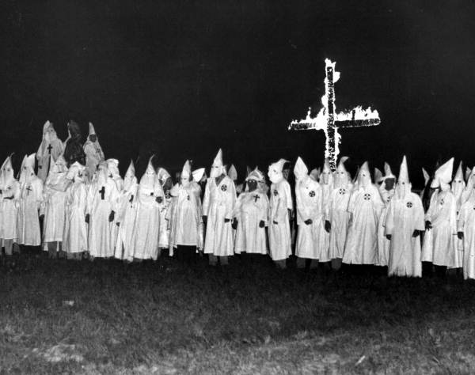
© Brain Wrinkles

Slide 39
Ku Klux Klan
The Ku Klux Klan used tactics of intimidation, physical violence, and murder in hopes of establishing social control over African Americans and their white allies.
The Klan spread terror throughout Georgia, and white supremacy and racial segregation became the norm for several decades.
© Brain Wrinkles

Slide 40
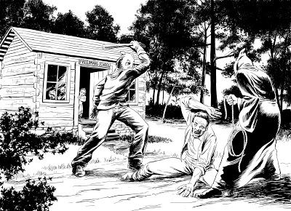
© Brain Wrinkles

Slide 41
Conflict Over
RECONSTRUCTION
PLANS
© Brain Wrinkles

Slide 42
Readmission
After the Civil War, it was obvious that Southern states had to be admitted back into the Union, but no one could agree on the best way to do so.
President Lincoln wanted to be as fair as possible to Southern states and let them back in quickly.
Lincoln’s plan was simple and did not require much from the Southern states in order to rejoin.
© Brain Wrinkles

Slide 43
Lincoln’s Plan
President Lincoln’s plan for rebuilding the South had three parts:
First, one-tenth of the people in the state had to take an oath to obey the U.S. Constitution.
Second, the state had to set up a new government with a new constitution.
Third, the state had to abolish slavery.
© Brain Wrinkles

Slide 44
Congress’ Plan
While Lincoln wanted to be fair to the South, many Radical Republicans felt that Lincoln’s plan was too lenient.
They felt that Southern states should be punished for their actions during the Civil War and the readmission process should be long and difficult.
© Brain Wrinkles

Slide 45
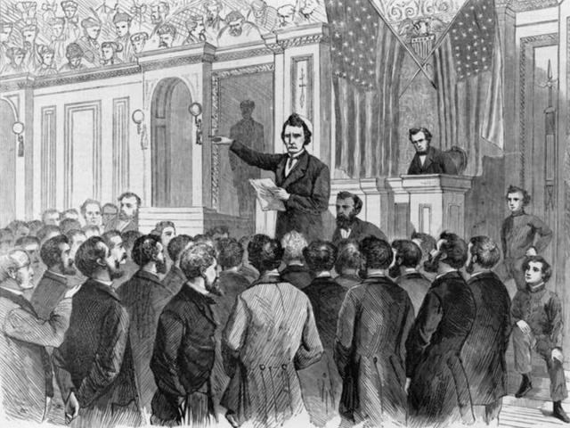
Radical Republicans fought against Lincoln’s Plan for Reconstruction
© Brain Wrinkles

Slide 46
Congress’ Plan
In July 1864, the Radical Republicans passed the Wade-Davis bill.
This was stricter and required the majority of voters to take a loyalty oath to the Union.
Lincoln vetoed the bill and rejected their plan.
© Brain Wrinkles

Slide 47
Johnson
In April 1865, President Lincoln was assassinated and Vice President Andrew Johnson took over the presidency.
President Johnson was committed to carrying out Lincoln’s Reconstruction plan and made very few changes.
© Brain Wrinkles

Slide 48
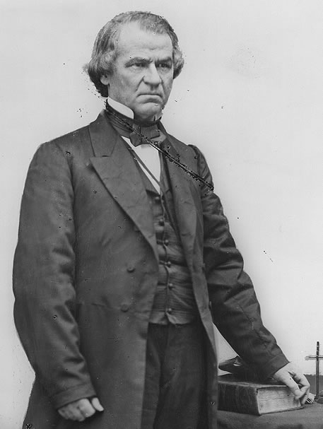
17th U.S. President Andrew Johnson
© Brain Wrinkles

Slide 49
Johnson’s Plan
President Johnson’s plan for Reconstruction was slightly stricter than Lincoln’s.
It said that Southern states could come back into the Union if they ratified the 13th Amendment.
Johnson made sure that the 13th Amendment to the Constitution was ratified in December 1865.
© Brain Wrinkles

Slide 50
13th Amendment
The 13th Amendment freed all slaves in the United States.
It abolished slavery in the US and any of its territories.
President Johnson said that once the amendment passed, Southern states could come back into the Union.
Congress did not agree with Johnson.
© Brain Wrinkles

Slide 51
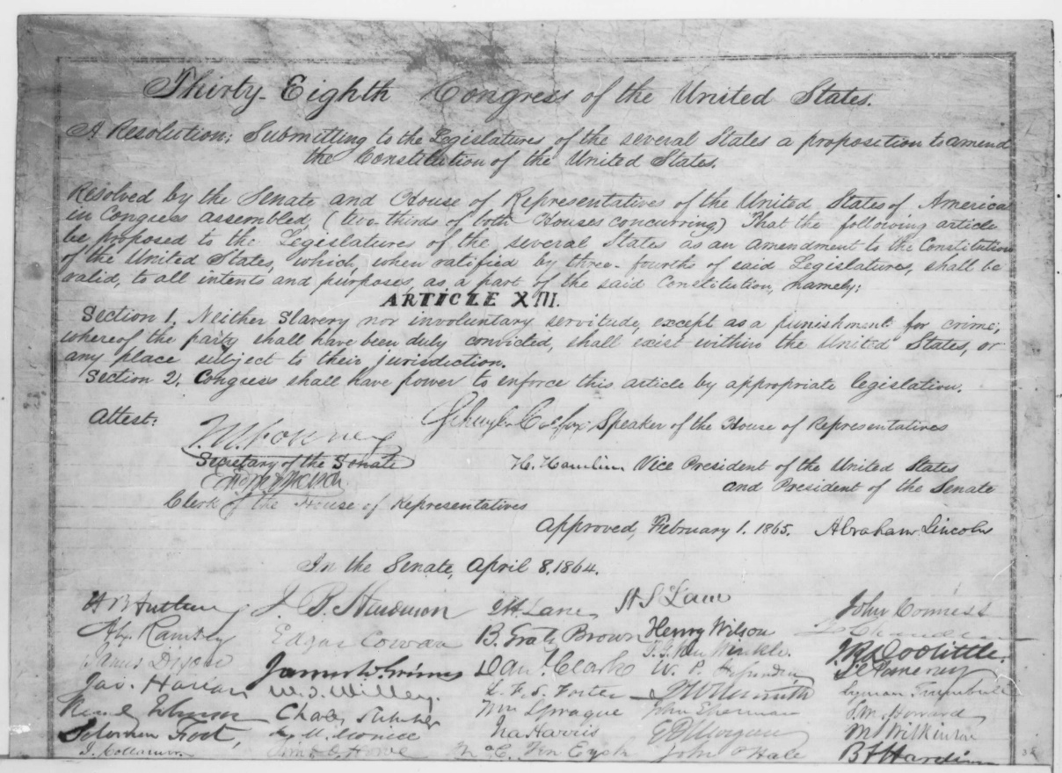
13th Amendment to the U.S. Constitution
It was approved by Abraham Lincoln in February, but was not ratified until December.
The 13th Amendment says, “Neither slavery nor involuntary servitude, except as a punishment for crime whereof the party shall have been duly convicted, shall exist within the United States, or any place subject to their jurisdiction.”
© Brain Wrinkles

Slide 52
14th Amendment
In 1868, Congress passed the 14th Amendment, which made all former slaves citizens of the United States.
It granted citizenship to all persons born in the United States, and it guaranteed all citizens equal rights under the law.
At first, Tennessee was the only Southern state to approve it, but Congress told the Southern states they must approve it to be readmitted to the Union.
© Brain Wrinkles

Slide 53
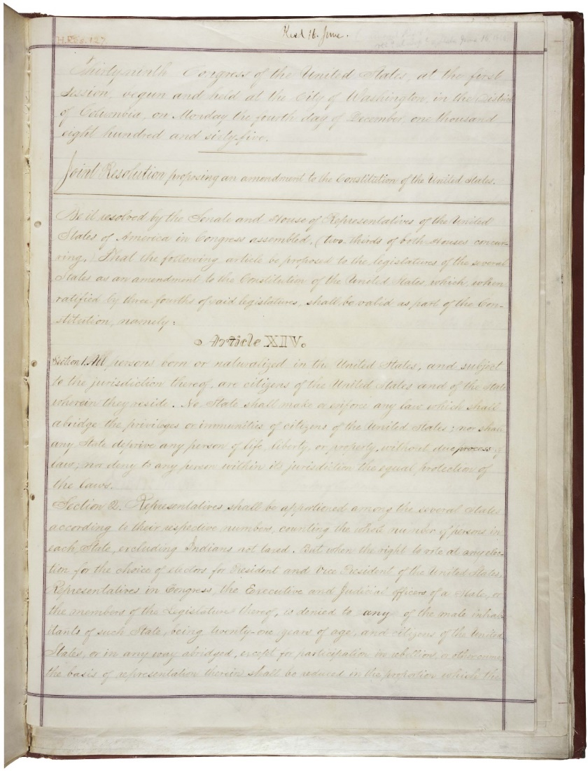
14th Amendment to the U.S. Constitution
The 14th Amendment says, “All persons born or naturalized in the United States and subject to the jurisdiction thereof, are citizens of the United States and of the State wherein they reside.”
© Brain Wrinkles

Slide 54
15th Amendment
In February 1870, the 15th Amendment to the U.S. Constitution was ratified.
It declared that no citizen of the United States could be denied the right to vote on account of race, color, or previous servitude.
The 15th Amendment granted the right to vote to all male citizens, and African Americans could now vote and run for office.
© Brain Wrinkles

Slide 55
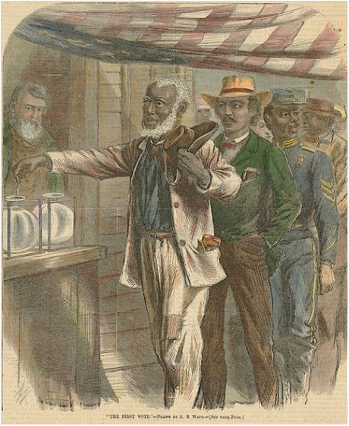
15th Amendment to the U.S. Constitution
The 15th Amendment says, “The right of citizens of the United States to vote shall not be denied or abridged by the color, or previous condition of servitude.”
© Brain Wrinkles

