Slide 1
Events Leading to the
CIVIL
WAR
and the Impact on Georgia
© Brain Wrinkles

Slide 2
Differences
Large differences divided the northern and southern states long before the Civil War started in 1861.
The two important issues that increased tensions were states’ rights and slavery.
© Brain Wrinkles

Slide 3
Tariff
During the 1800s, farming was the way of life in the South while numerous factories were being built in the North.
Northerners wanted to sell their goods in the South, but it was cheaper for Southerners to import goods from Europe.
In 1828, President Jackson put a tariff on imported goods to help Northern industries.
© Brain Wrinkles

Slide 4
Nullification
Southerners were angry and opposed the tariff because it was put in place to help northern businessmen, rather than southern plantation owners.
In 1832, South Carolina invoked the doctrine of nullification, saying that the tariff was not valid in the state and threatened to withdraw from the Union.
To avoid this, Congress lowered the tariff in 1833.
© Brain Wrinkles

Slide 5
States’ Rights
Many Southerners were angry because they believed the national government was intruding more and more on states’ rights.
(The authority states have to govern what goes on inside their own borders.)
Many Southern states felt that states should have final authority, not the national government.
© Brain Wrinkles

Slide 6
States’ Rights
Many people in the South believed that states could choose which federal laws to obey.
They felt that if a state didn’t like a law passed by the federal government, then they didn’t have to follow it.
Many also believed that any state could withdraw, or secede, from the Union if it chose to do so.
© Brain Wrinkles

Slide 7
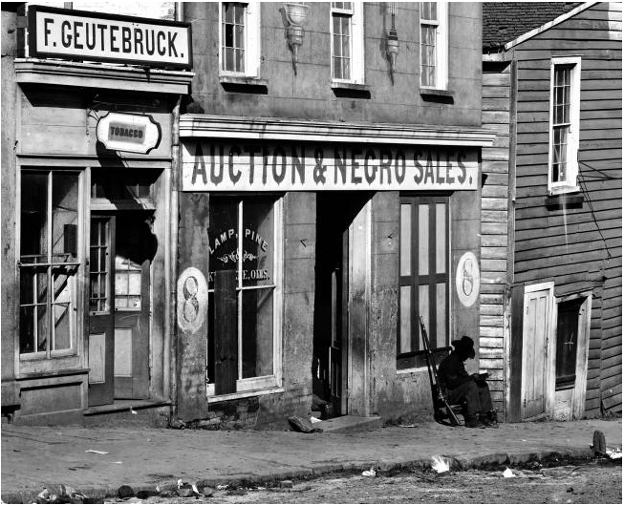
Slave Trader’s Business in Atlanta, 1860s
© Brain Wrinkles

Slide 8
Slavery
When the US Constitution was written, it did not include anything on slave labor.
Slavery was a matter of states’ rights and each state could decide whether or not to allow slaves.
In the 1800s, slavery became a heated issue between the North and the South.
© Brain Wrinkles

Slide 9
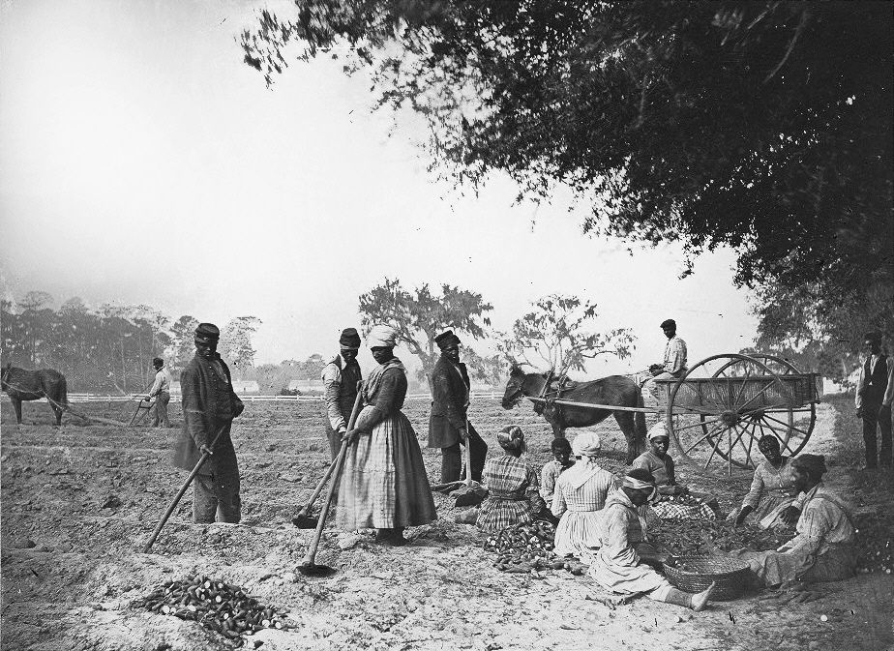
A South Carolina Plantation - 1862
© Brain Wrinkles

Slide 10
The South
The South relied on cash crops, like cotton, and depended heavily on (free) slave labor to work the large plantations.
Plantation owners needed slaves to plant cotton, harvest it, and operate the cotton gins.
The economy of the South depended on slave labor.
© Brain Wrinkles

Slide 11
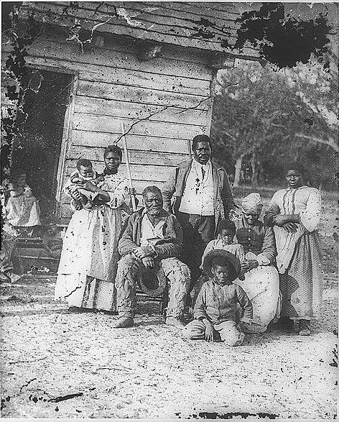
Four Generations of a Slave Family– Beaufort, South Carolina 1862
© Brain Wrinkles

Slide 12
The North
The North relied mostly on factories and businesses, and did not need slaves in order to maintain its economy.
Many Northern abolitionists spoke out against the evils of slavery and wanted it to end, while Southerners wanted to protect their way of life.
Wealthy Southern plantation owners resented Northern interference in their livelihood.
© Brain Wrinkles

Slide 13
Division
Soon, arguments began to arise between the North and the South over whether slavery should be allowed in new states added to the Union.
Kentucky Senator Henry Clay convinced Congress that there must be a compromise in order to make both sides happy.
© Brain Wrinkles

Slide 14
Missouri
In 1820, Congress approved the Missouri Compromise in an effort to appease both sides.
The slave state of Missouri applied for statehood, but admitting Missouri would upset the balance between free and slave states.
© Brain Wrinkles

Slide 15
Compromise
Lawmakers created a compromise plan that admitted Missouri as a slave state and Maine as a free state.
They also decided to limit areas that could apply for statehood as a slave state.
All new states north of a certain point would be free, and all states south of that point would allow slavery.
© Brain Wrinkles

Slide 16
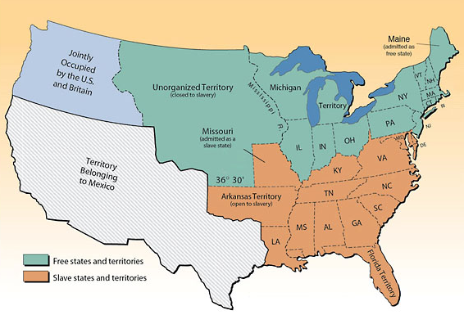
Missouri Compromise
© Brain Wrinkles

Slide 17
Compromise of 1850
The slavery issue continued to cause division when the U.S. gained more territory after the war with Mexico in 1848.
The Compromise of 1850 admitted California as a free state and made no decision on the new territories of New Mexico and Utah.
The slave trade was also abolished in Washington D.C., although slavery was still permitted there.
© Brain Wrinkles

Slide 18
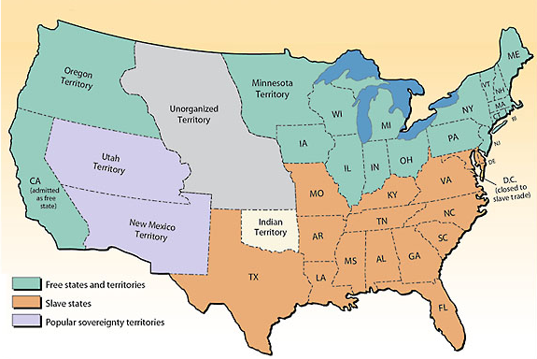
Compromise of 1850
© Brain Wrinkles

Slide 19
Fugitive
Slave Act
To pacify slave states, the Compromise of 1850 also included the Fugitive Slave Act.
The act required runaway slaves to be returned to the South even if they had made it to free territory the North.
It also punished anyone who helped runaway slaves.
© Brain Wrinkles

Slide 20
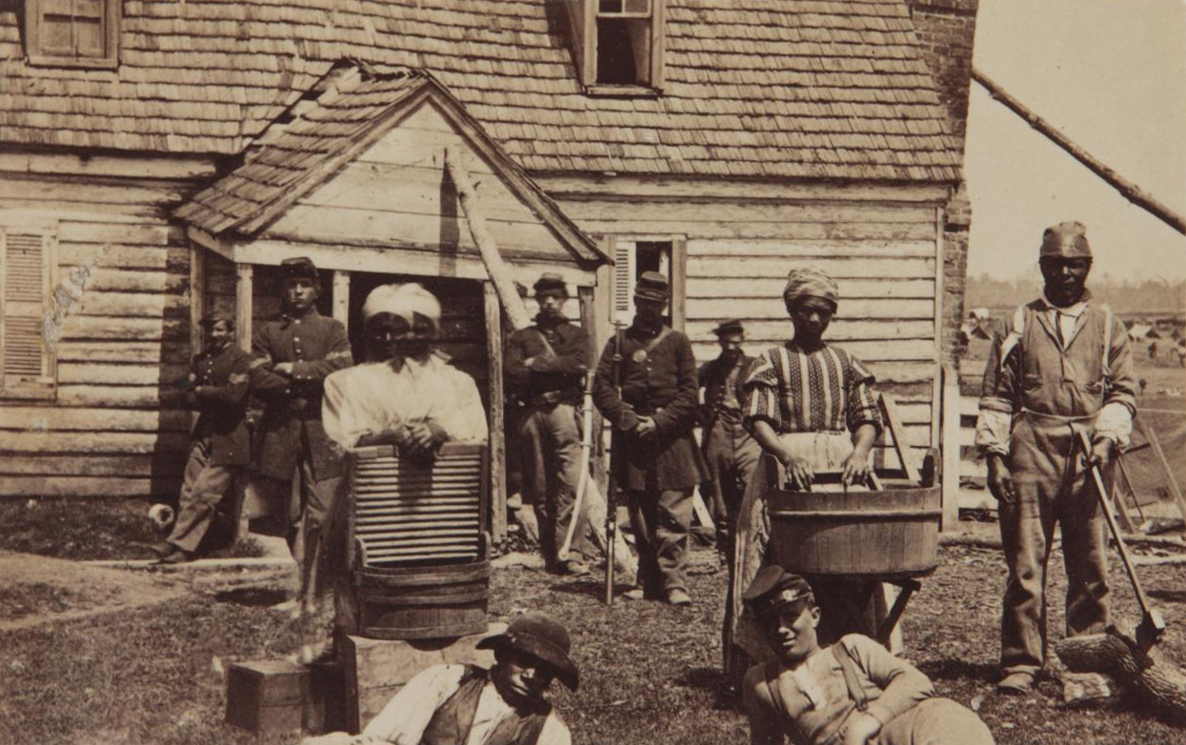
Runaway Slaves - 1852
© Brain Wrinkles

Slide 21
GA Platform
The Compromise of 1850 did not pass easily.
Many Georgians still opposed the compromise and threatened secession.
In December 1850, Georgia’s lawmakers met to discuss the issue and adopted the Georgia Platform.
© Brain Wrinkles

Slide 22
GA Platform
The Georgia Platform stated that Georgia was willing to accept the Compromise of 1850 as long as the North complied with the Fugitive Slave Act.
Georgia would remain in the Union as long as the North promised to help return runaway slaves to the South and would stop trying to ban slavery in new territories and states.
© Brain Wrinkles

Slide 23
Issue
Another controversial event that sparked anger was the Dred Scott v. Sanford case in 1857.
Dred Scott, a Missouri slave, sued for his freedom because he had lived for a period of time with his master in Illinois and Wisconsin (both free).
When he returned to Missouri, Scott sued the state based on his belief that his time in the free states made him a free man.
© Brain Wrinkles

Slide 24
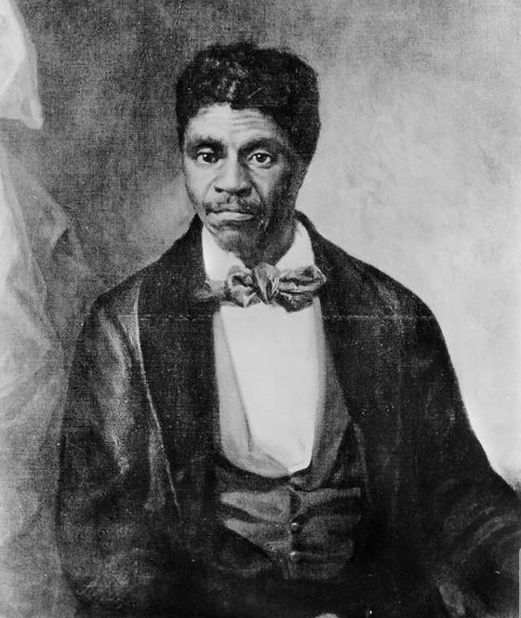
Dred Scott
© Brain Wrinkles

Slide 25
Dred Scott
Many slaves who had lived in free territory had gone to court and gained their freedom, and Dred Scott believed he should be able to do the same.
When Scott sued for his freedom, the U.S. Supreme Court had to decide if slaves could gain freedom just by living in a free territory.
This case gave the Supreme Court the opportunity to make a national statement either for or against slavery.
© Brain Wrinkles

Slide 26
Ruling
The Supreme Court ruled against Dred Scott, declaring that slaves and freed blacks were not citizens of the U.S. and did not have the right to sue in the first place.
It went on to state that banning slavery in U.S. territories was unconstitutional.
The Court declared that the national government had no right to stop the expansion of slavery into western territories.
© Brain Wrinkles

Slide 27
Outcome
The Supreme Court sided with the southern view on slavery, so Southern slaveholders were pleased with the decision.
The Dred Scott case’s outcome made Northern abolitionists furious because it meant that slave owners could keep their slaves in any state.
The court’s decision further divided the nation.
© Brain Wrinkles

Slide 28
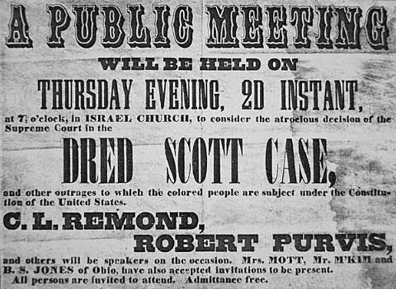
© Brain Wrinkles

Slide 29
New Party
In 1854, those opposing the spread of slavery united and formed the Republican Party.
Initially, the party only sought to restrict slavery in new states and territories, not outlaw it where it already existed.
In 1860, the Republicans nominated Abraham Lincoln of Illinois as their candidate for president of the United States.
© Brain Wrinkles

Slide 30
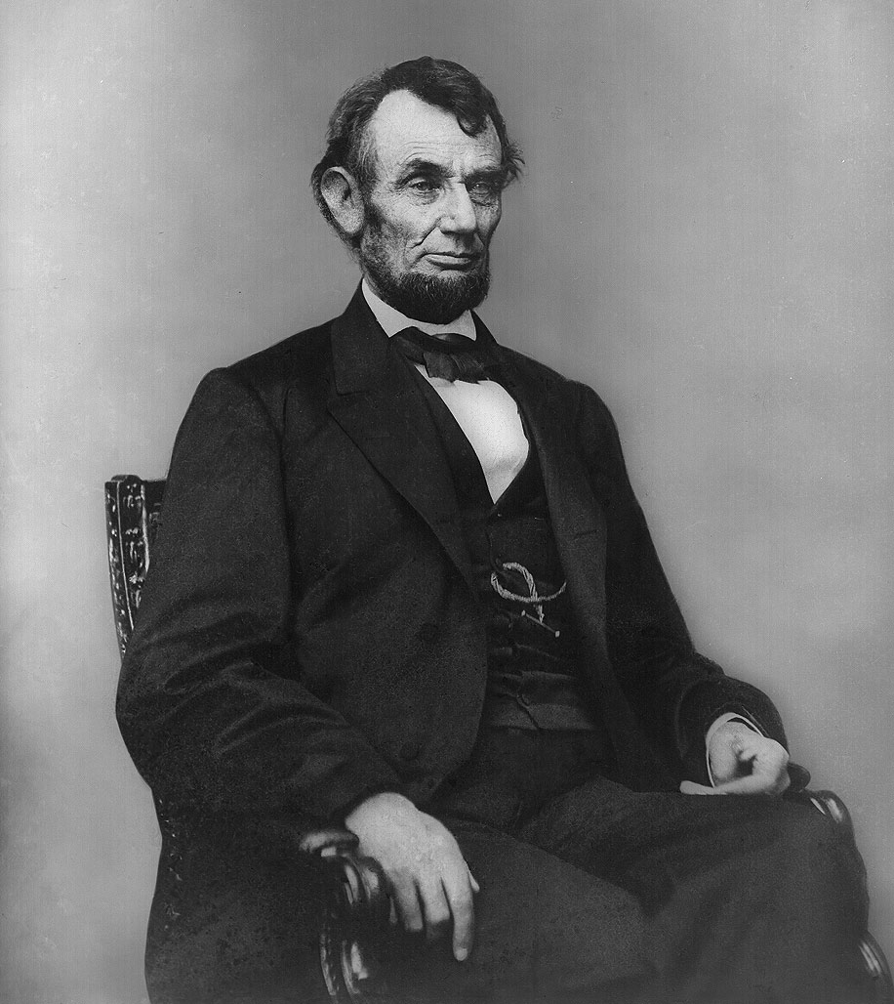
Abraham Lincoln
in 1864
© Brain Wrinkles

Slide 31
Split
The Democratic party was split between three candidates.
Northern democrats supported Senator Stephen Douglas, who had proposed the idea of popular sovereignty in the territories (idea that power would be given to citizens).
Southern Democrats opposed Douglas and nominated Kentucky’s John Breckinridge.
A third group, the Constitutional Union Party, nominated Tennessee’s John Bell.
© Brain Wrinkles

Slide 32
1860 Election
Abraham Lincoln won the election on November 6, 1860.
Southern states were concerned because they felt Lincoln wanted to end slavery.
Lincoln’s goal was to keep the Union together; however, South Carolina decided to secede from the Union on December 20, 1860.
© Brain Wrinkles

Slide 33
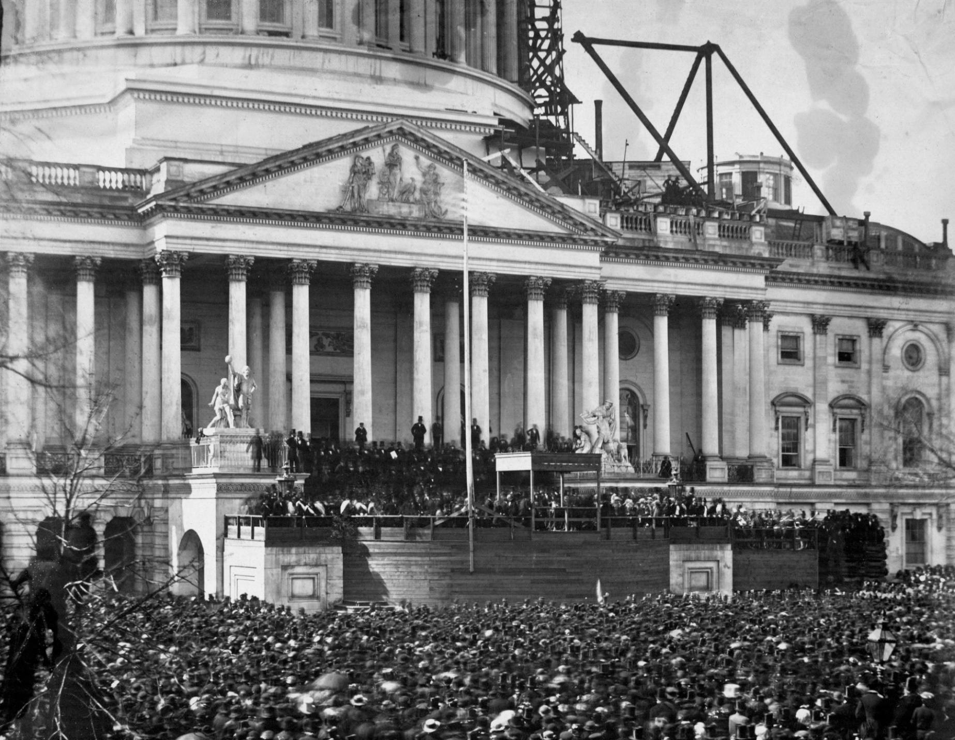
President Lincoln’s Inauguration
© Brain Wrinkles

Slide 34
Debate
When South Carolina seceded from the Union, Georgians were divided in two.
One group, including Governor Joseph Brown, wanted to leave the Union right away.
Alexander Stephens disagreed and said that Lincoln was not the South’s enemy.
He also warned of the economic ruin that would occur from a civil war.
© Brain Wrinkles

Slide 35
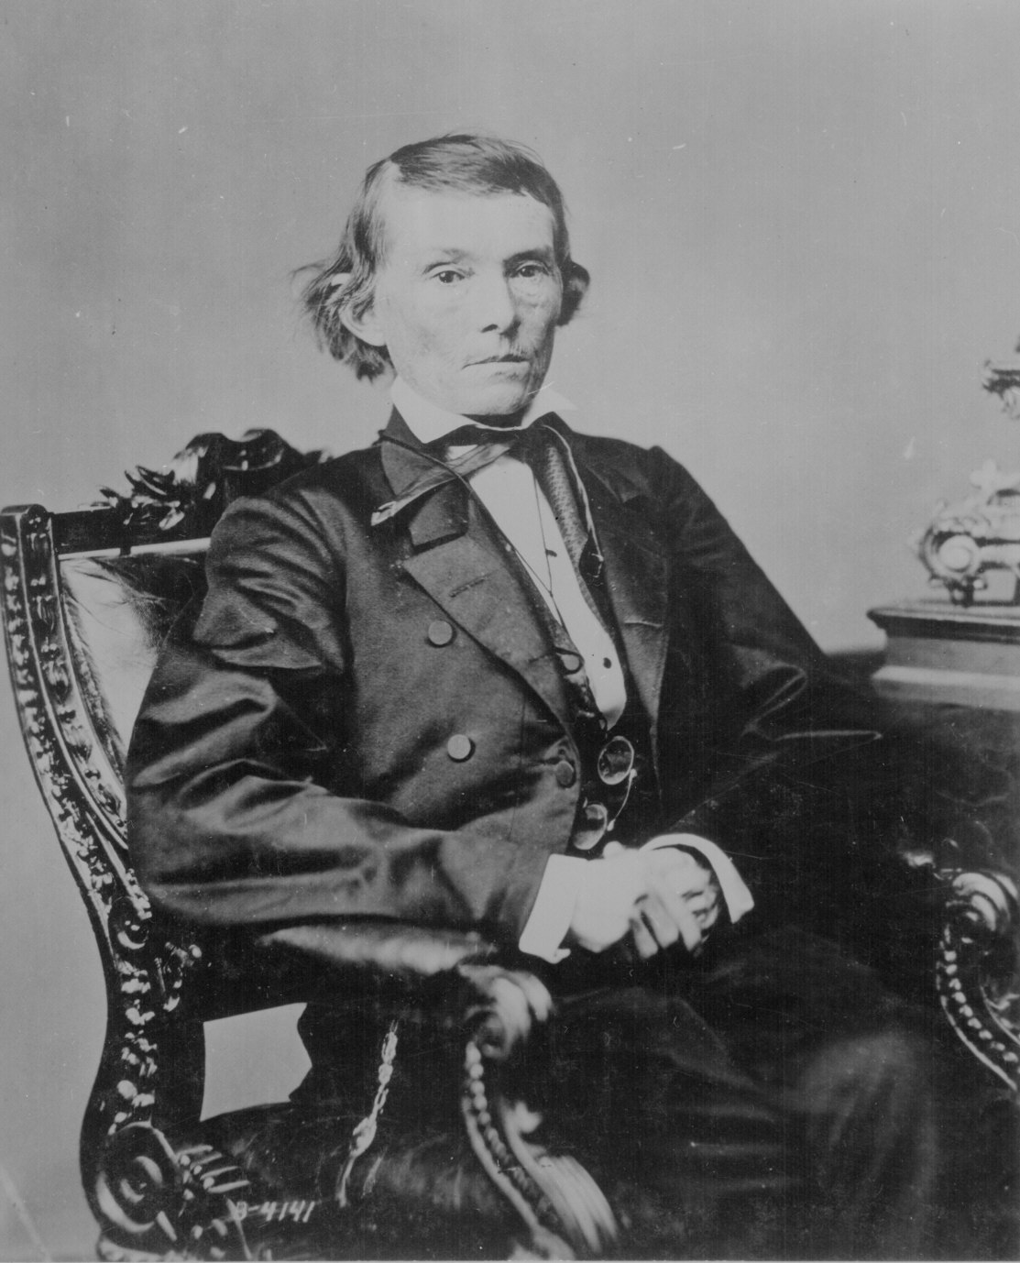
Alexander Stephens was a sickly man who never weighed over 100 pounds. Still, one northern politician called him “the strongest man in the South”.
© Brain Wrinkles

Slide 36
GA Secession
Georgia’s legislature called a special secession convention in order to vote on the issue.
Delegates voted 166 to 130 in favor of secession.
In January of 1861, Georgians left the Union.
© Brain Wrinkles

Slide 37
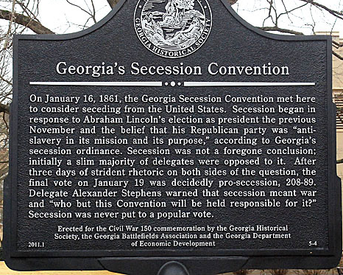
© Brain Wrinkles

Slide 38
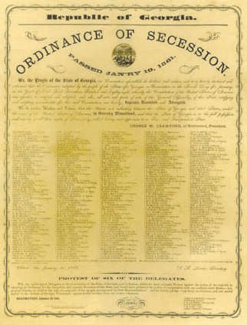
© Brain Wrinkles

Slide 39
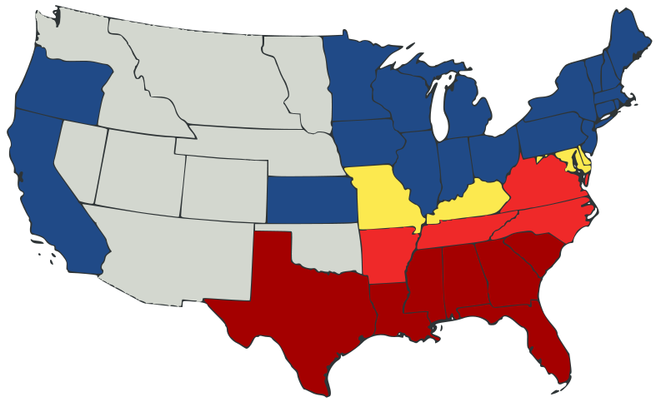
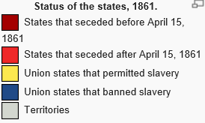
Status of the States 1861
© Brain Wrinkles

Slide 40
TEACHER INFO: North v. South Show Me Game
Print off the cards on the following page. (There are two-per-page).
Project the following “Show Me” statements and have the students hold up the correct end of the card.
There is also a blank template for you to add additional questions if you’d like. *Or have the students write one of their own!
© Brain Wrinkles

Slide 41
N
S
North
South
S
N
North
South

Slide 42
SHOW ME!
The economy of this region was highly dependent on cash crops, such as cotton.
© Brain Wrinkles

Slide 43
ANSWER:
South
© Brain Wrinkles

Slide 44
SHOW ME!
Under the Georgia Platform, this region had to agree to comply with the Fugitive Slave Act.
© Brain Wrinkles

Slide 45
ANSWER:
North
© Brain Wrinkles

Slide 46
SHOW ME!
These states were free.
© Brain Wrinkles

Slide 47
ANSWER:
North
© Brain Wrinkles

Slide 48
SHOW ME!
The court ruled in this region’s favor in the Dred Scott case.
© Brain Wrinkles

Slide 49
ANSWER:
South
© Brain Wrinkles

Slide 50
SHOW ME!
The abolitionist movement began in this region.
© Brain Wrinkles

Slide 51
ANSWER:
North
© Brain Wrinkles

Slide 52
SHOW ME!
These states were slave states.
© Brain Wrinkles

Slide 53
ANSWER:
South
© Brain Wrinkles

Slide 54
SHOW ME!
This region’s economy was based on industry.
© Brain Wrinkles

Slide 55
ANSWER:
North
© Brain Wrinkles

Slide 56
SHOW ME!
This region strongly supported states’ rights.
© Brain Wrinkles

Slide 57
ANSWER:
South
© Brain Wrinkles

Slide 58
SHOW ME!
During the election of 1860, supporters of Abraham Lincoln and the Republican Party lived in this region.
© Brain Wrinkles

Slide 59
ANSWER:
North
© Brain Wrinkles

Slide 60
SHOW ME!
States in this region wanted to nullify the Tariff of 1828.
© Brain Wrinkles

Slide 61
ANSWER:
South
© Brain Wrinkles

Slide 62
SHOW ME!
After the election of 1860, states from this region began to secede from the Union.
© Brain Wrinkles

Slide 63
ANSWER:
South
© Brain Wrinkles

