Slide 1
Creek & Cherokee
INDIAN
REMOVAL
© Brain Wrinkles

Slide 2
Removal of the
CREEKS
© Brain Wrinkles

Slide 3
Allies
During the Revolutionary War, many American Indians in Georgia fought as allies of the British.
The British promised to return land taken by white settlers if Britain won the war.
However, once the war was over, Georgians desired to push American Indians out.
© Brain Wrinkles

Slide 4
Creeks
The Creek Nation was prominent in southwestern Georgia and was the most populous tribe in the state.
Many white Georgians desired the land the Creek used for deer hunting, so they pushed for Indian removal.
In 1790, the Treaty of York forced the Creek to cede the land east of the Ocmulgee River to the government.
© Brain Wrinkles

Slide 5
Land
When Georgia ceded the Yazoo Lands to the federal government in 1802, the US government agreed to remove the American Indians still in Georgia.
In 1823, Governor George Troup pressured the federal government to drive the Creeks from their remaining land.
They negotiated with Troup’s first cousin, Creek chief William McIntosh, who was the son of a Scottish officer and a Creek woman.
© Brain Wrinkles

Slide 6
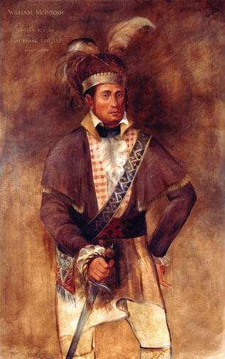
Chief William McIntosh
© Brain Wrinkles

Slide 7
McIntosh
William McIntosh angered Creeks by siding often with the US government over matters of Indian land.
He also believed it was best for American Indians to assimilate to the ways of white men.
McIntosh was in favor of changing the traditional Creek lifestyle to one of agricultural production and slaveholding.
Most Creeks did not support his abandonment of their customs.
© Brain Wrinkles

Slide 8
Removal
McIntosh signed the Treaty of Indian Springs in 1825, which gave up all Creek lands to the government of Georgia.
Many Creeks were enraged with McIntosh and a 200-warrior war party murdered him and several other leaders who had signed the treaty.
Nevertheless, by 1827, the Creeks were removed from Georgia and relocated to the wilderness across the Mississippi River.
© Brain Wrinkles

Slide 9
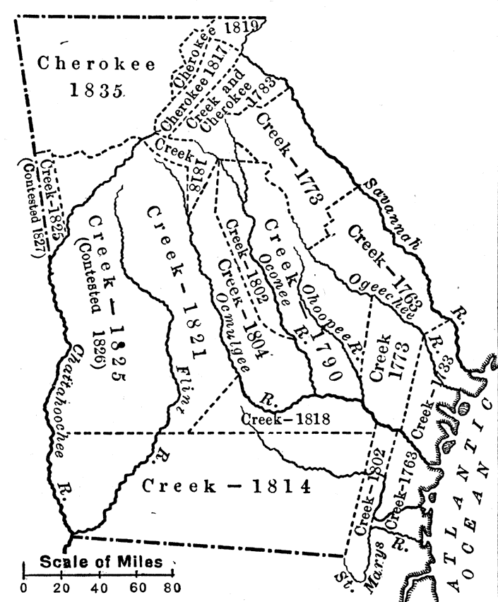
Indian Cessions in Georgia
© Brain Wrinkles

Slide 10
Removal of the
CHEROKEE
© Brain Wrinkles

Slide 11
Cherokee
Georgia’s other main American Indian tribe was the Cherokee, who lived in northwest Georgia.
They created an advanced society with a constitution and an independent government.
© Brain Wrinkles

Slide 12
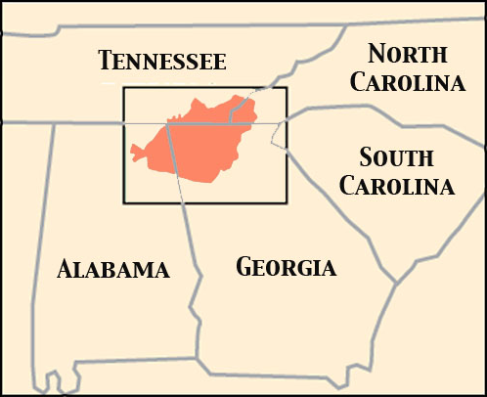
Cherokee Nation
© Brain Wrinkles

Slide 13
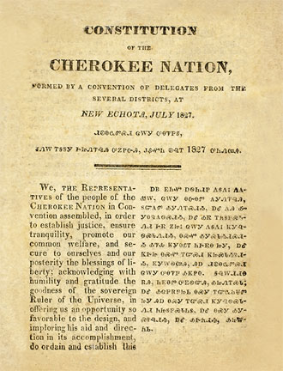
Cherokee
Constitution
© Brain Wrinkles

Slide 14
John Ross
In 1791, the U.S. government signed a treaty guaranteeing that the Cherokee nation could be independent and have its own government.
The Cherokee government was modeled after the U.S. federal government and was led by Chief John Ross.
He was the son of a Scottish father and part-Cherokee, part-Scottish mother.
© Brain Wrinkles

Slide 15
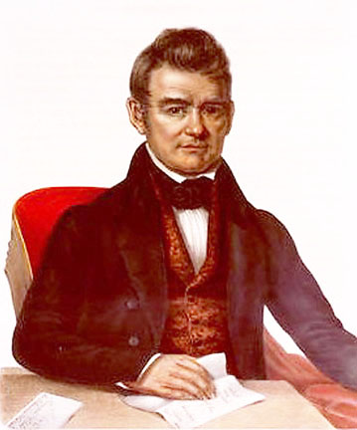
Cherokee
Chief
John Ross
© Brain Wrinkles

Slide 16
Gold Rush
In 1828, white Georgians began lobbying for Cherokee removal from the state.
Around this time, gold was discovered in the region and pretty much sealed the deal on the Cherokee losing their land.
The Dahlonega Gold Rush brought thousands of settlers who put more and more pressure on the Cherokee to move.
© Brain Wrinkles

Slide 17
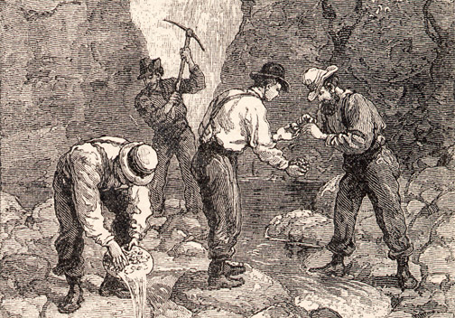
The discovery of gold in Dahlonega hastened the removal of the Cherokee from Georgia.
© Brain Wrinkles

Slide 18
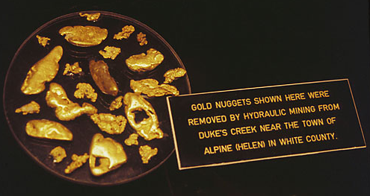
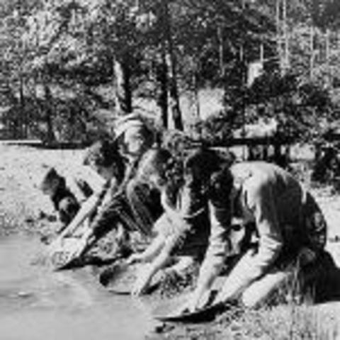
© Brain Wrinkles

Slide 19
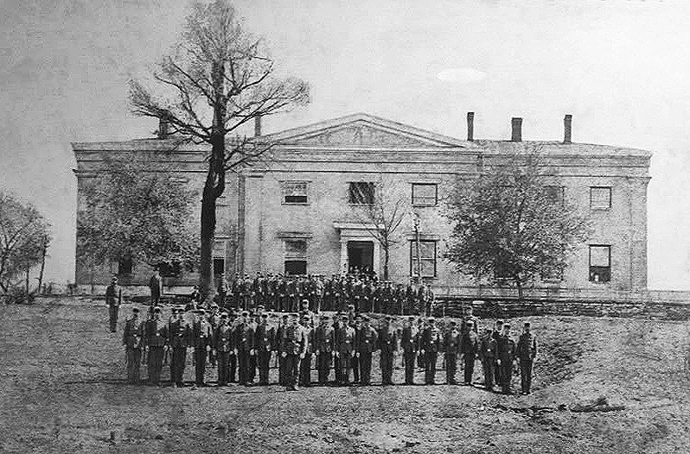
The government had to set up a mint to produce gold coins because so much gold was found.
© Brain Wrinkles

Slide 20
New Laws
In 1828, Georgia lawmakers said that state laws were now in effect in the Cherokee lands.
The General Assembly began passing laws denying the Cherokee rights to both the land and gold.
In 1830, Congress passed the Indian Removal Act which ordered all Indians east of the Mississippi River to leave their homes and move west.
© Brain Wrinkles

Slide 21
Supreme Court
The Cherokee nation fought the removal and chief John Ross argued their case before the US Supreme Court.
In 1832, Chief Justice John Marshall ruled in favor of the Cherokee in Worcester v. Georgia.
The decision declared that the Cherokee Nation was a sovereign nation and did not need to obey Georgia or US laws.
© Brain Wrinkles

Slide 22
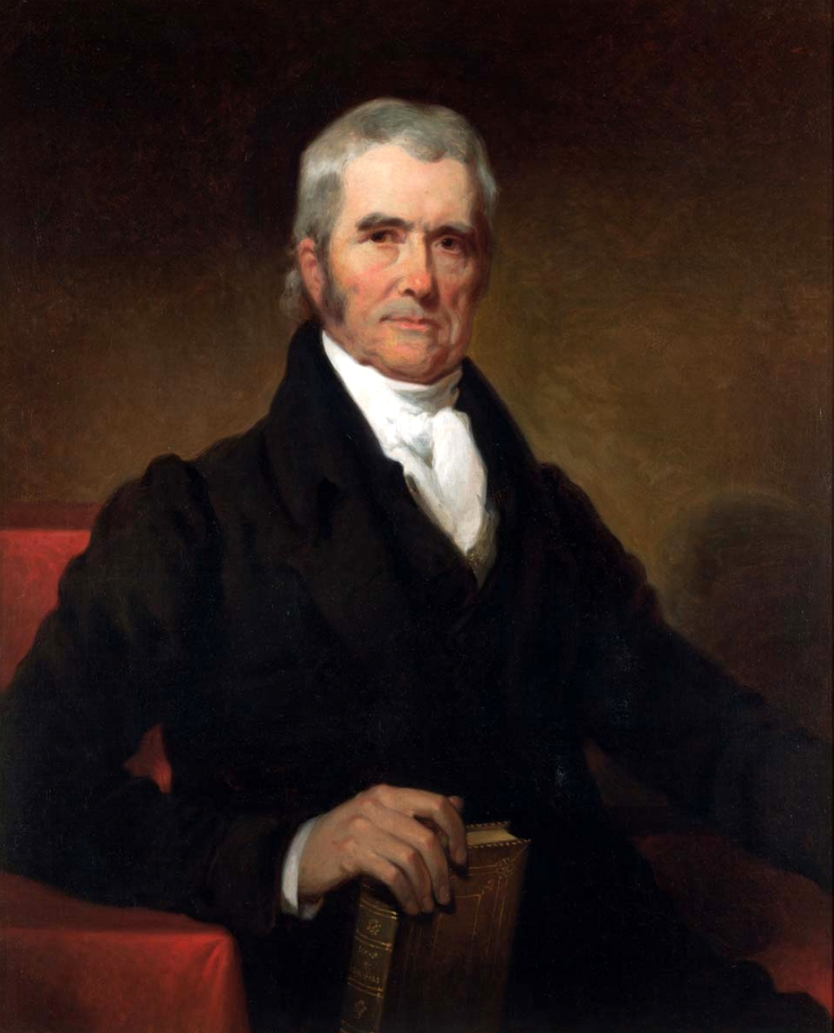
Chief Justice John Marshall
© Brain Wrinkles

Slide 23
Jackson
President Andrew Jackson was frustrated by the decision and chose to ignore it.
He believed firmly in Indian removal and wanted to get the Cherokee out of Georgia.
By not enforcing the Supreme Court ruling, Jackson did not meet his Constitutional requirements as president.
© Brain Wrinkles

Slide 24
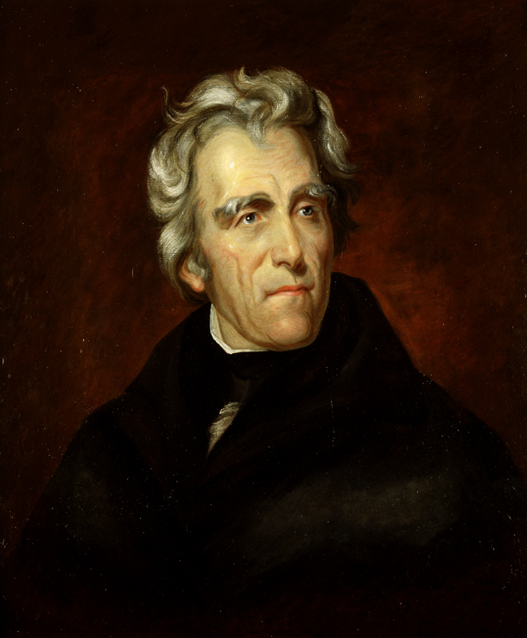
President
Andrew Jackson
© Brain Wrinkles

Slide 25
Not Enforced
Worcester v. Georgia should have protected Cherokee lands from white settlement.
Because it was not enforced by President Jackson, nothing was done to protect the Cherokee and Georgians continued to settle on Cherokee land.
© Brain Wrinkles

Slide 26
Removal
In 1835, the US government forced the Cherokee to sign a treaty giving up all of their lands in Georgia.
In 1838, the US Army forcibly rounded up 14,000 Cherokee men, women, and children.
The troops forced the Cherokee on a 800-mile march across the Southeast to Indian territory in Oklahoma.
© Brain Wrinkles

Slide 27
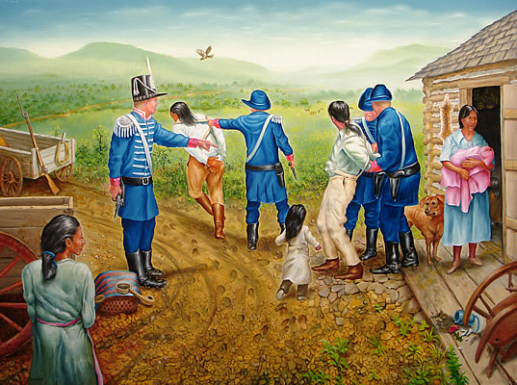
© Brain Wrinkles

Slide 28
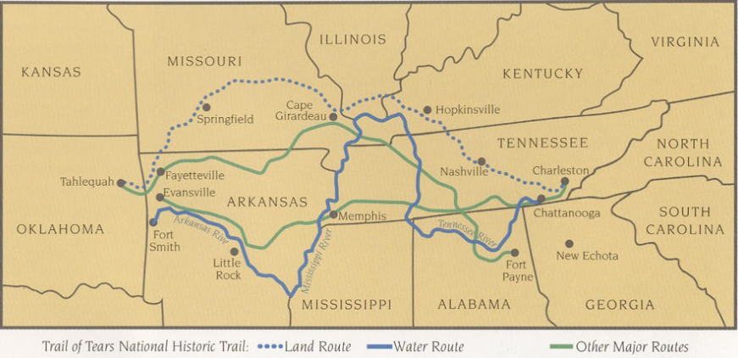
© Brain Wrinkles

Slide 29
Trail of Tears
More than 4,000 men, women, and children died from disease, starvation, and exposure to the cold weather during the six-month trek.
The Cherokee called it the “trail where they cried”.
Today, it is known as the Trail of Tears.
© Brain Wrinkles

Slide 30
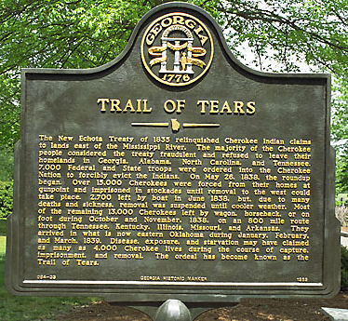
© Brain Wrinkles

Slide 31
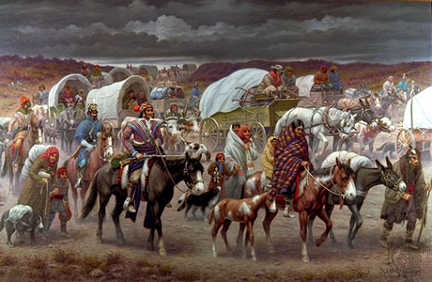
© Brain Wrinkles

