Slide 1
Georgia’s Role in the
CIVIL
WAR
© Brain Wrinkles

Slide 2
Confederacy
After Abraham Lincoln was elected president in 1860, seven Southern states seceded from the Union.
Lincoln was firmly against the spread of slavery, and Southerners were worried that he would eventually destroy their livelihood.
The Southern states formed the Confederate States of America and elected Jefferson Davis as president of the Confederacy.
© Brain Wrinkles

Slide 3
Lincoln
Abraham Lincoln was inaugurated as the U.S.’ 16th president on March 4, 1861.
Lincoln’s goal was to “preserve the Union” and he asked the Southern states to consider rejoining.
He addressed the slavery issue by stating that he would not “interfere with the institution of slavery in the states where it exists.”
It was not enough, though, and the Civil War officially began when Confederate troops opened fire on Fort Sumter on April 12, 1861.
© Brain Wrinkles

Slide 4
Fort Sumter
Fort Sumter was a Union fort that protected the harbor of Charleston, South Carolina.
The Union forces inside Fort Sumter were already low on ammunition and food, so they surrendered the next day.
Nobody was killed during the actual battle; however, one person was killed in a 50-gun salute to the flag.
© Brain Wrinkles

Slide 5
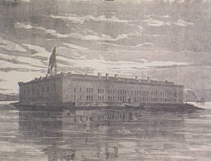
Fort Sumter (before the Civil War)
© Brain Wrinkles

Slide 6
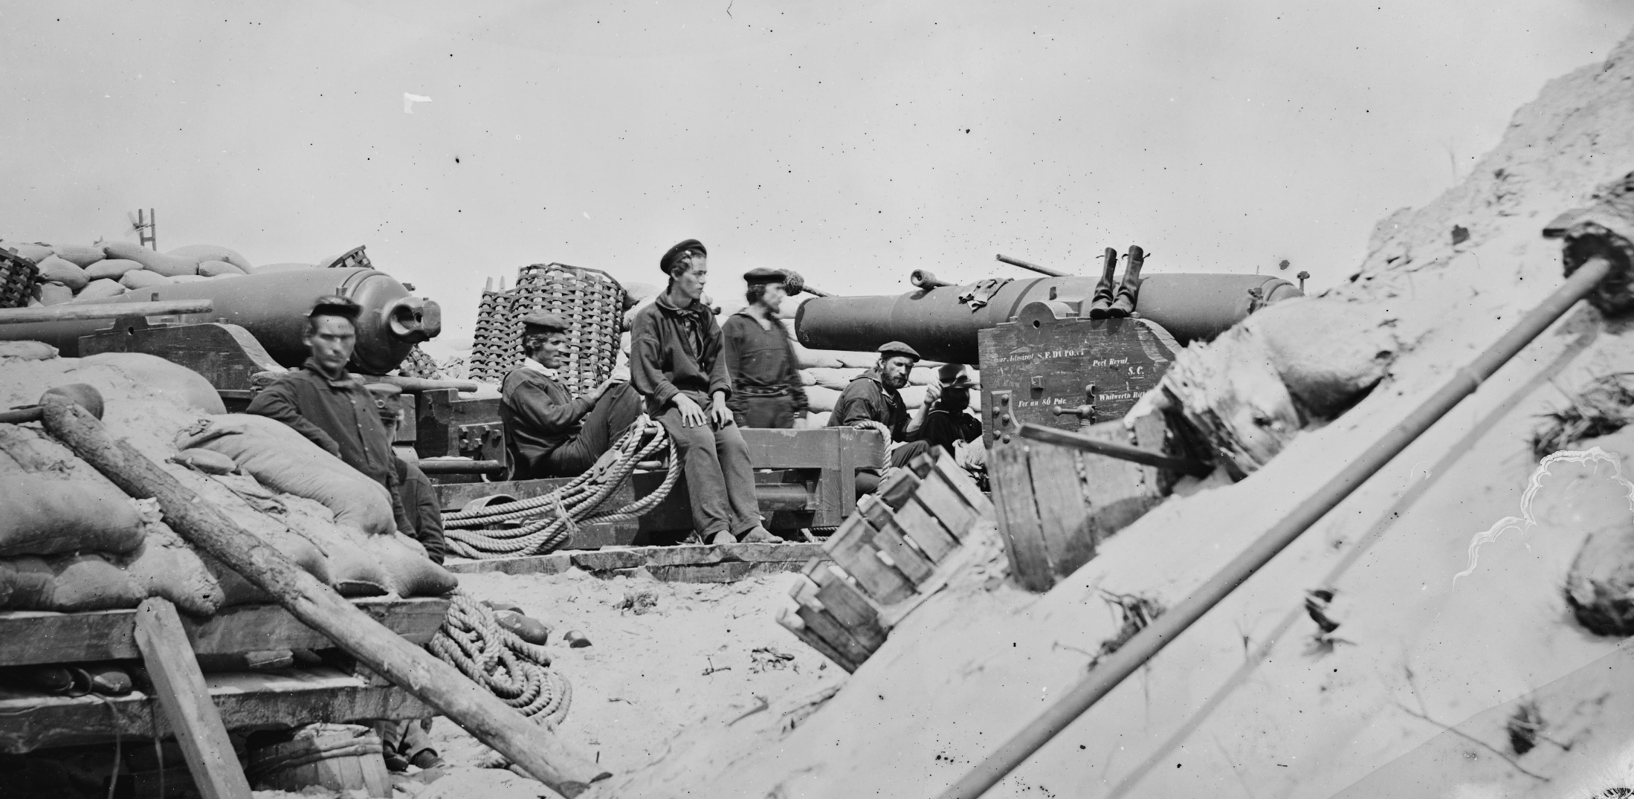
Whitworth Rifles in defense of Charleston.
© Brain Wrinkles

Slide 7
Blockade
In response, Union leaders quickly set up a blockade of Southern ports in order to cutoff Confederate commerce and weaken the South.
Union ships lined the southern coast and would not let any Confederate ships in or out.
Occasionally, blockade runners snuck through and were able to make it to Europe to trade for supplies.
© Brain Wrinkles

Slide 8
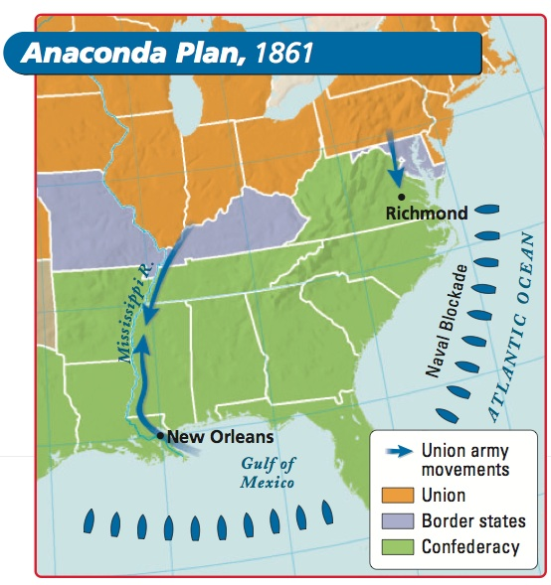
© Brain Wrinkles

Slide 9
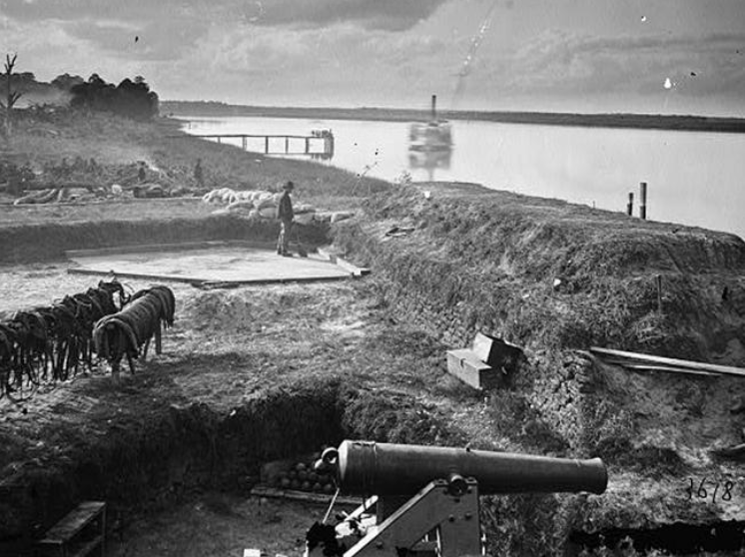
Union Battleship off of Georgia’s Coast
© Brain Wrinkles

Slide 10
Blockade
In April 1862, Union soldiers landed on Tybee Island and captured Fort Pulaski, the fort protecting Savannah.
Once the brick fort was obliterated, the North was able to blockade the important port of Savannah.
Hardly any Confederate ships could make it in or out of Georgia.
© Brain Wrinkles

Slide 11
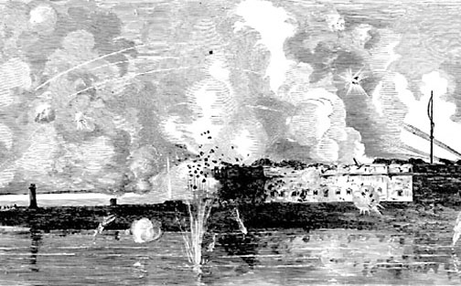
Fort Pulaski Bombardment
© Brain Wrinkles

Slide 12
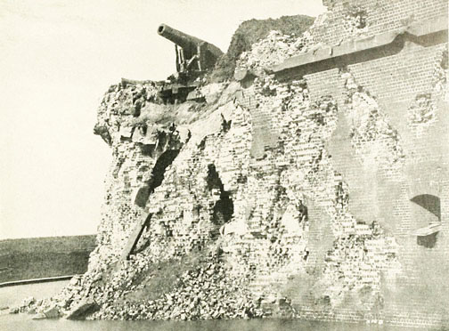
Fort Pulaski Bombardment
© Brain Wrinkles

Slide 13
Emancipation
Five days after the Union victory in the Battle of Antietam, President Lincoln issued the Emancipation Proclamation.
This freed all slaves in states fighting against the Union.
Lincoln’s proclamation shifted the focus of the Civil War from preserving the Union to freeing the slaves.
© Brain Wrinkles

Slide 14
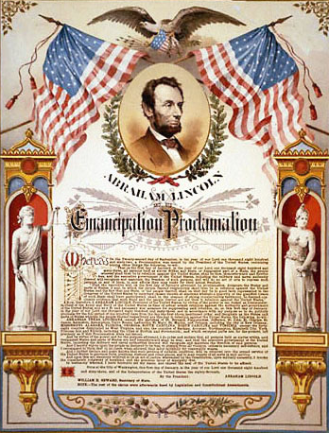
© Brain Wrinkles

Slide 15
Emancipation
For Southerners, the Emancipation Proclamation was final proof that the North would destroy the southern way of life.
Northern abolitionists saw the emancipation of slaves as a great victory, and now had a valuable reason to fight.
With the proclamation, President Lincoln made it clear that the Union’s purpose was now to free the slaves.
© Brain Wrinkles

Slide 16
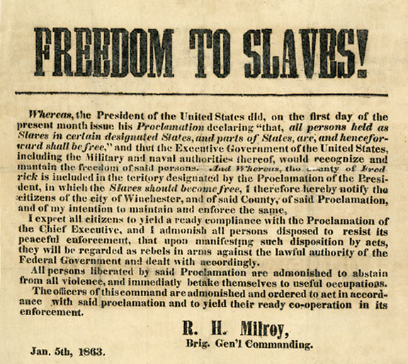
© Brain Wrinkles

Slide 17
Emancipation
The Emancipation Proclamation also invited former slaves to join the Union army.
Many African Americans enlisted and fought bravely, aware that they were fighting for the freedom of their people.
As the Union Army freed slaves, an estimated 3,500 black Georgians joined the Union against the Confederates.
© Brain Wrinkles

Slide 18
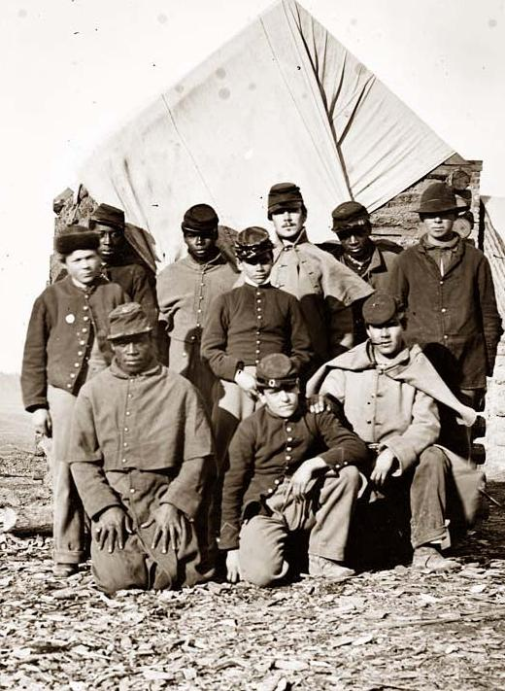
Many fugitive slaves fled to the Union Army. They were officially freed with the Emancipation Proclamation in 1863.
© Brain Wrinkles

Slide 19
Georgia
Georgia was free from major battles during the first two years of the Civil War.
The Union soon realized that destroying Atlanta would mean defeat for the Confederacy.
In 1863, Georgia became a target for the Union.
© Brain Wrinkles

Slide 20
Chickamauga
After capturing Chattanooga, a railroad center in Tennessee, 58,000 Union troops marched south into Georgia on September 18, 1863.
66,000 Confederates fought against the Union soldiers along Chickamauga Creek for two days.
© Brain Wrinkles

Slide 21
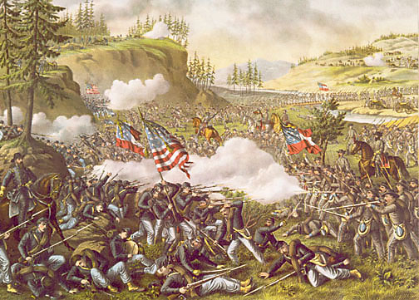
© Brain Wrinkles

Slide 22
Chickamauga
After 16,000 men were killed from both sides, the Union army retreated back to Tennessee.
The Battle of Chickamauga was a very important Confederate victory and it became the largest Union defeat.
© Brain Wrinkles

Slide 23
Atlanta
Campaign
In 1864, General William Tecumseh Sherman moved his Union Army south from Tennessee to Atlanta.
They fought Confederate soldiers along the way, leaving a path of destruction and chaos.
© Brain Wrinkles

Slide 24
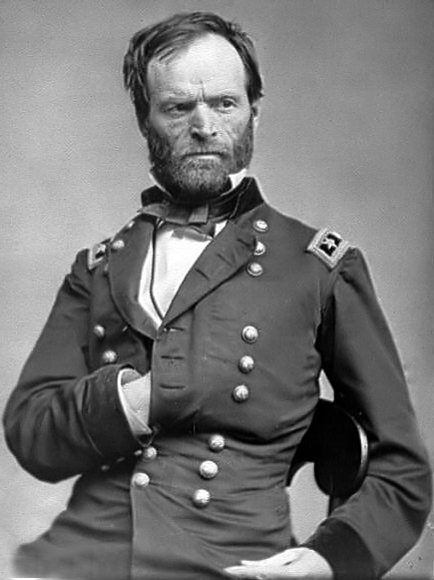
Union General
William Tecumseh Sherman
© Brain Wrinkles

Slide 25
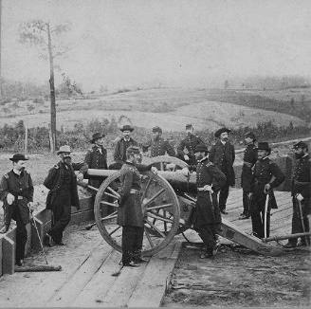
General Sherman & His Officers in Atlanta
© Brain Wrinkles

Slide 26
Atlanta
Campaign
On September 2, 1864, Sherman’s troops captured Atlanta and set the city on fire.
Sherman’s Atlanta Campaign marked the beginning of the end of the Civil War.
© Brain Wrinkles

Slide 27
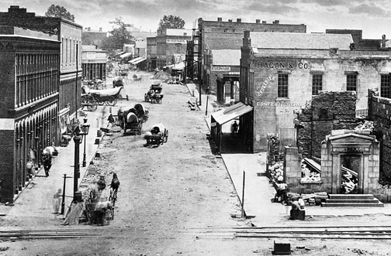
Atlanta’s Peachtree Street after Sherman
© Brain Wrinkles

Slide 28
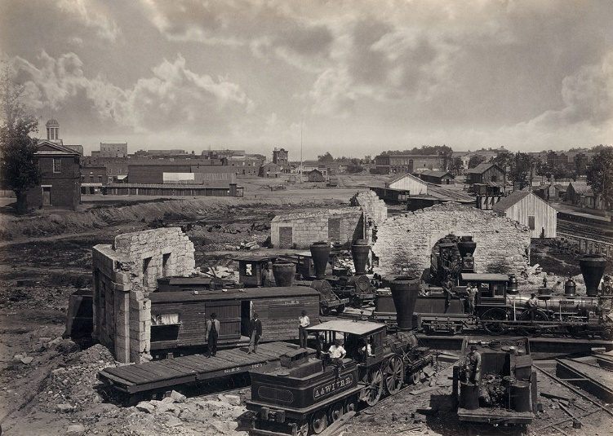
Destroyed Train Roundhouse in Atlanta
© Brain Wrinkles

Slide 29
March to
the Sea
The next day, Sherman split his army in two and continued his “March to the Sea” from Atlanta to Savannah.
Sherman instructed his soldiers to destroy any towns and plantations along the way in order to crush the remaining fighting spirit in the South.
© Brain Wrinkles

Slide 30
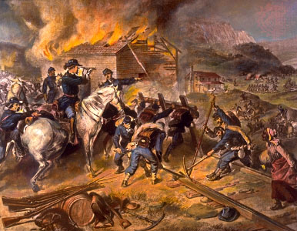
© Brain Wrinkles

Slide 31
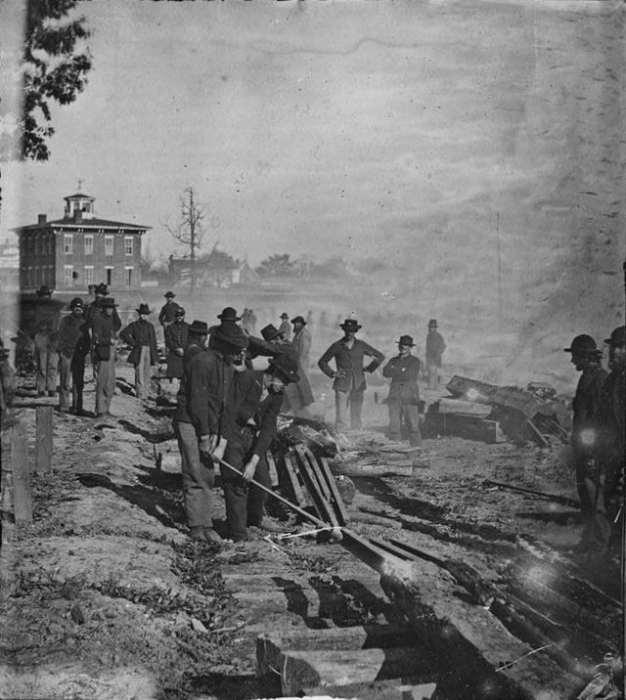
Sherman’s Men Destroying Georgia’s Railroads
© Brain Wrinkles

Slide 32
March to
the Sea
Half of Sherman’s army marched through Decatur, Covington, Eatonton, and Milledgeville, while the other half traveled through Jonesboro and Gordon.
The two groups met in Sandersville and headed on to Savannah.
© Brain Wrinkles

Slide 33
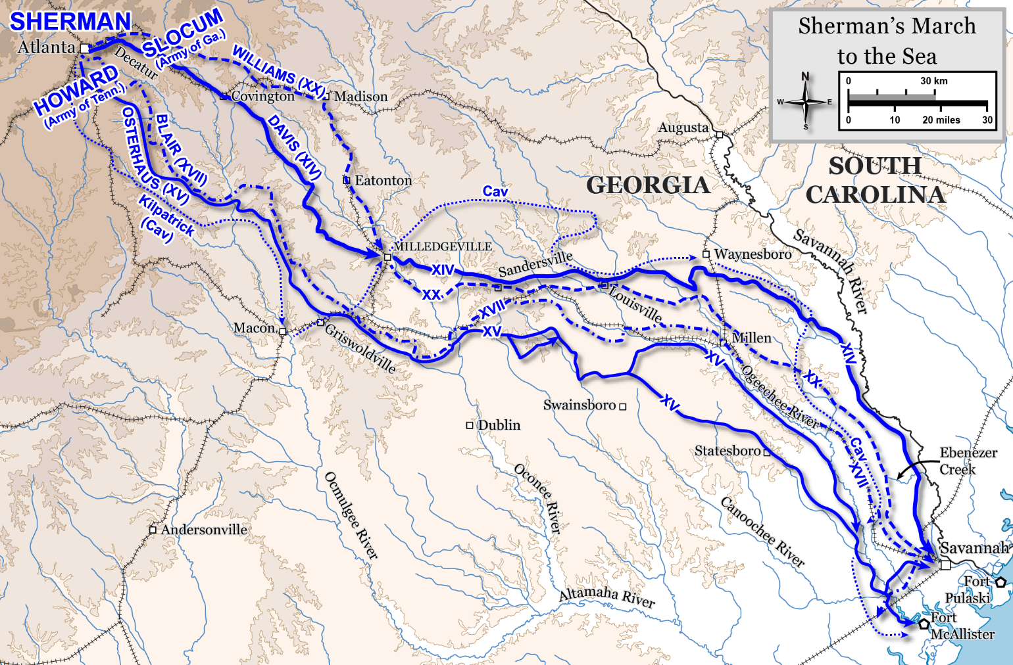
© Brain Wrinkles

Slide 34
March to
the Sea
Sherman’s march cut Confederate supply lines and crushed the spirit of the Confederate army.
Union troops captured Savannah on December 21, 1864, and Sherman presented the city of Savannah to Abraham Lincoln as a Christmas gift.
The Confederacy surrendered in April 1865.
© Brain Wrinkles

Slide 35
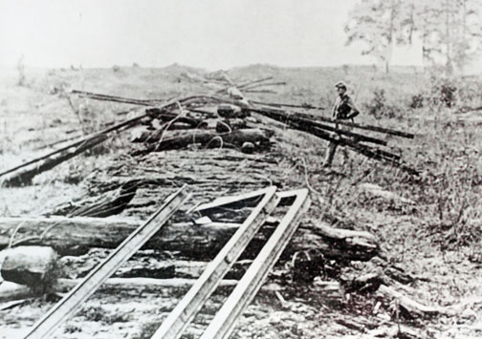
Sherman Estimated the Property Damage at $100 million
© Brain Wrinkles

Slide 36
Andersonville
One of the most notorious sites of the Civil War was the Confederate prison camp in Andersonville, Georgia.
More than 45,000 captured Union soldiers were sent to the overcrowded camp.
© Brain Wrinkles

Slide 37
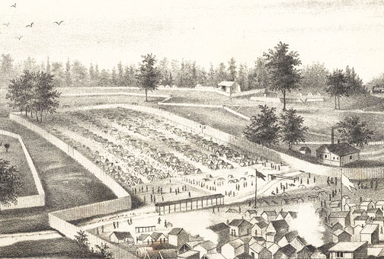
Andersonville Prison
© Brain Wrinkles

Slide 38
Conditions
Inside the prison, there was barely any food to eat and the only water source was a filthy stream that flowed through the camp.
Prisoners lived outside with few clothes and had to construct their own shelters made from sticks, cloth scraps, and mud.
Living conditions were terrible and many suffered from starvation, disease, and insect attacks.
© Brain Wrinkles

Slide 39
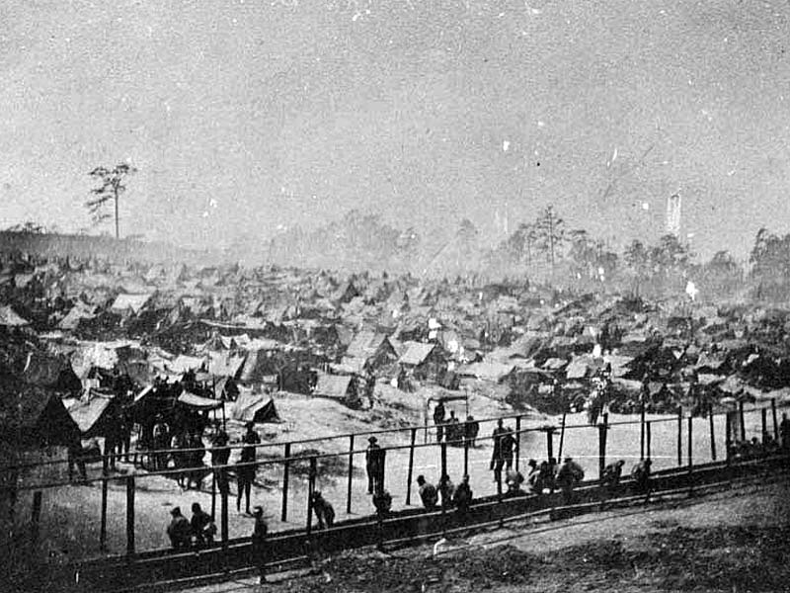
© Brain Wrinkles

Slide 40
Prison Camp
The prison was overcrowded and unsanitary, and over 13,000 of the captives died of disease and starvation.
Prisoners lacked life’s basic necessities inside Andersonville’s walls.
The camp had the highest death rate of any Civil War prison.
After the war, the Union executed the prison’s commander, Major Henry Wirz.
© Brain Wrinkles

Slide 41
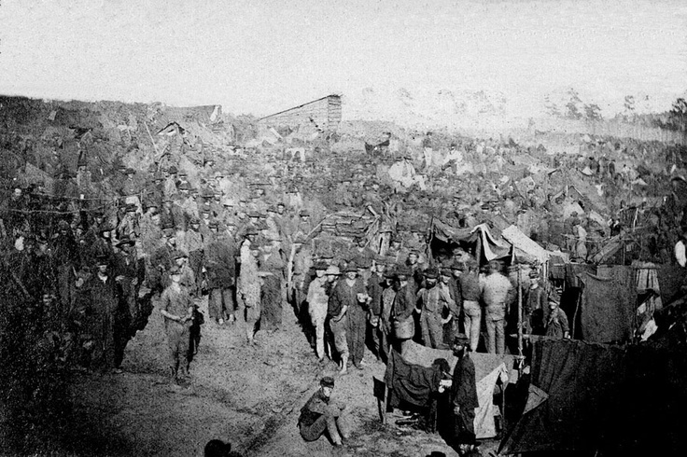
Andersonville Prison
© Brain Wrinkles

