Slide 1
Activation Activity
Using the article provided and your book, please complete the following reading Guide

Slide 2
Write 5 facts or four or more words about the Articles of Confederation or the Georgia Constitution of 1777
F
I
R
S
T
T
R
Y

Slide 3
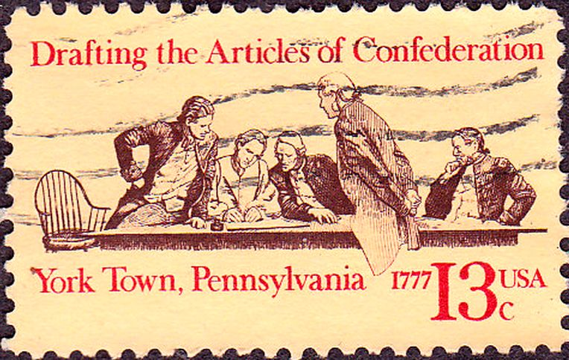
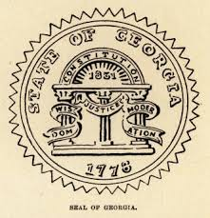
Georgia Constitution and The Articles of Confederations

Slide 4
Standards
The student will describe the impact of events that led to the ratification of the United States Constitution and Bill of Rights
Analyze the strengths and weaknesses of both the Georgia Constitution of 1777 and the Articles of Confederation and explain how weaknesses in the Articles of Confederation led to a need to revise the Articles
Describe the role of Georgia at the Constitutional Convention of 1787; include the role of Abraham Baldwin and William Few, and reasons why Georgia ratified the new constitution.

Slide 5
Word Review
Ratify- To approve or make valid
Unicameral - Consisting of a single branch, chamber or house, as a legislative assembly.
Bicameral - having two branches, chambers, or houses, as a legislative body.
Confederation - local/state governments make their own laws. A weak overlying central government.

Slide 6
Lesson Three (SS8H4a) – The student will analyze the strengths and weaknesses of both the Georgia Constitution of 1777 and the Articles of Confederation and explain how weakness in the Articles of Confederation led to a need to revise the Articles.
The Georgia Constitution of 1777:
YOU CAN’T BEAT SOMETHING…
WITH NOTHING…
SS8H4 – The student will describe the impact of events that led to ratification of the United States Constitution and the Bill of Rights

Slide 7
Lesson Three (SS8H4a) – The student will analyze the strengths and weaknesses of both the Georgia Constitution of 1777 and the Articles of Confederation and explain how weakness in the Articles of Confederation led to a need to revise the Articles.
The Georgia Constitution of 1777:
When Georgia declared their independence from England…
…they had to replace English government with a government of their own.
SS8H4 – The student will describe the impact of events that led to ratification of the United States Constitution and the Bill of Rights

Slide 8
Lesson Three (SS8CG1b) – The student will explain the concepts of separation of powers and checks and balances.
The Georgia Constitution of 1777:
In creating a government, several important things must be remembered in order to protect a nation from tyranny!!!
SS8CG1 – The student will describe the role of citizens under Georgia’s constitution.

Slide 9
Lesson Three (SS8CG1b) – The student will explain the concepts of separation of powers and checks and balances.
The Georgia Constitution of 1777:
All governments must have three basic functions (responsibilities):
The Legislative function –makes the law
The Executive function – enforces or executes the law
The Judicial function –interprets or explains the law
SS8CG1 – The student will describe the role of citizens under Georgia’s constitution.

Slide 10
Lesson Three (SS8CG1b) – The student will explain the concepts of separation of powers and checks and balances.
The Georgia Constitution of 1777:
The three basic functions must be present and must be kept
equally powerful.
Without the legislative function, there would be no laws to interpret or to enforce.
Without the executive function, laws could be written and understood, but could not be enforced. A LAW IS NOT A LAW UNLESS THEY HURT WHEN BROKEN!!!
Without the judicial function, laws could be created but could not be explained in order to be enforced.
SS8CG1 – The student will describe the role of citizens under Georgia’s constitution.

Slide 11
Lesson Three (SS8CG1b) – The student will explain the concepts of separation of powers and checks and balances.
The Georgia Constitution of 1777:
3. The three basic functions must be kept separate in order to keep one group or person from becoming too powerful.
Hitler could make his own laws, interpret them however he pleased and enforce them against anyone who displeased him!!!
SS8CG1 – The student will describe the role of citizens under Georgia’s constitution.

Slide 12
Lesson Three (SS8CG1b) – The student will explain the concepts of separation of powers and checks and balances.
The Georgia Constitution of 1777:
4. The fundamental laws of the government must be written down as a Constitution in order to create a written record of the rights of the people and the limits of the government’s power.
SS8CG1 – The student will describe the role of citizens under Georgia’s constitution.

Slide 13
Lesson Three (SS8CG1b) – The student will explain the concepts of separation of powers and checks and balances.
The Georgia Constitution of 1777:
5. The people must have a higher law or Power to appeal to in case the government is ineffective or begins to abuse its power.
䇾We hold these truths to be self evident, that all men are created equal, that we are endowed by our Creator with certain inalienable rights…
– Declaration of Independence
SS8CG1 – The student will describe the role of citizens under Georgia’s constitution.

Slide 14
Lesson Three (SS8H4a) – The student will analyze the strengths and weaknesses of both the Georgia Constitution of 1777 and the Articles of Confederation and explain how weakness in the Articles of Confederation led to a need to revise the Articles.
The Georgia Constitution of 1777:
In creating its new government, the leaders of Georgia did not want the executive function to be too powerful. After all, they did not want to remove one powerful executive,
King George III, only to replace him with another.
SS8H4 – The student will describe the impact of events that led to ratification of the United States Constitution and the Bill of Rights

Slide 15
The Georgia Constitution of 1777
1777 – 1789 (12 years)
Based on the principles of the Declaration of Independence
Not capable of meeting the needs of governing the state.
Three Branches of Government

Slide 16
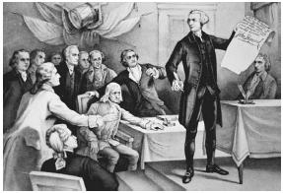
Legislative
Unicameral, or one branch
Powers
Appoint members of the judicial and executive branch

Slide 17
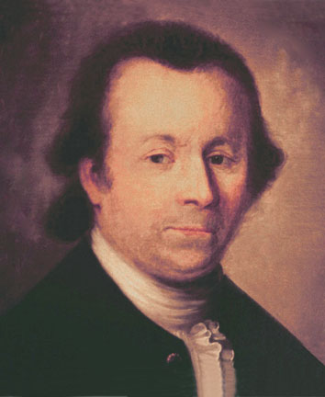
Executive Branch
Governor
Appointed by legislative branch
Limited to a ONE year term
Very little power

Slide 18
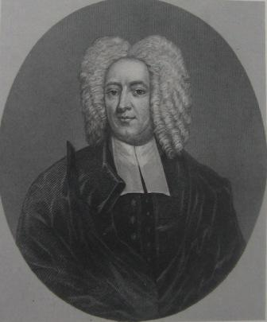
Judicial Branch
All Courts
Legislature appointed the positions for this branch

Slide 19
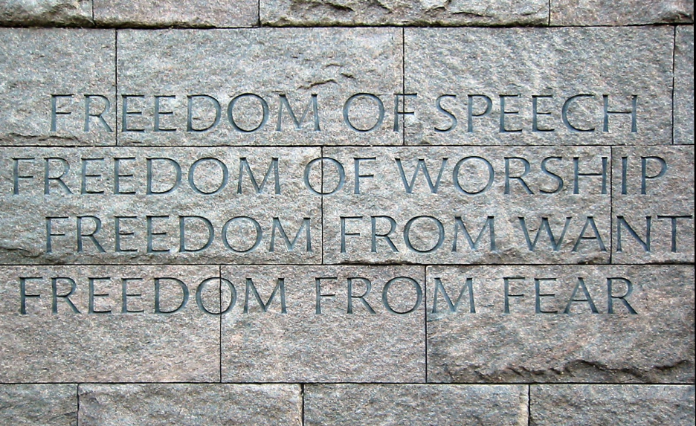
Freedoms of the People
Freedom of :
Press
Religion
Trial by jury
The people were not given the opportunity to ratify the constitution

Slide 20
Lesson Three (SS8H4a) – The student will analyze the strengths and weaknesses of both the Georgia Constitution of 1777 and the Articles of Confederation and explain how weakness in the Articles of Confederation led to a need to revise the Articles.
The Georgia Constitution of 1777:
STRENGTHS
1. The Constitution of 1777 was written down.
2. The Constitution of 1777 separated the three basic functions.
3. The Constitution of 1777 protected basic rights.
SS8H4 – The student will describe the impact of events that led to ratification of the United States Constitution and the Bill of Rights

Slide 21
Lesson Three (SS8H4a) – The student will analyze the strengths and weaknesses of both the Georgia Constitution of 1777 and the Articles of Confederation and explain how weakness in the Articles of Confederation led to a need to revise the Articles.
The Georgia Constitution of 1777:
WEAKNESSES
The three functions were not equally powerful. Instead, the legislative branch was most powerful.
The governor was dependent entirely upon the legislature (who elected him and chose his council) and was in office for too short a period to be effective.
Since most Georgians had been Tories, the Constitution of 1777, written by Whigs, was never sent to the people for ratification (approval).
SS8H4 – The student will describe the impact of events that led to ratification of the United States Constitution and the Bill of Rights

Slide 22
Lesson Three (SS8H4a) – The student will analyze the strengths and weaknesses of both the Georgia Constitution of 1777 and the Articles of Confederation and explain how weakness in the Articles of Confederation led to a need to revise the Articles.
The Articles of Confederation:
Just as Georgia began to create its own state government, the 2nd Continental Congress drafted the Articles of Confederation as the first Constitution of a new national government.
SS8H4 – The student will describe the impact of events that led to ratification of the United States Constitution and the Bill of Rights

Slide 23
Lesson Three (SS8H4a) – The student will analyze the strengths and weaknesses of both the Georgia Constitution of 1777 and the Articles of Confederation and explain how weakness in the Articles of Confederation led to a need to revise the Articles.
The Articles of Confederation:
Just like the Georgians who wrote the Constitution of 1777, the members of the 2nd Continental Congress wanted to avoid creating a strong central government with a powerful executive like they experienced under British rule.
SS8H4 – The student will describe the impact of events that led to ratification of the United States Constitution and the Bill of Rights

Slide 24
Lesson Three (SS8H4a) – The student will analyze the strengths and weaknesses of both the Georgia Constitution of 1777 and the Articles of Confederation and explain how weakness in the Articles of Confederation led to a need to revise the Articles.
The Articles of Confederation:
The Articles of Confederation, the first national constitution, went into effect on March 1, 1781.
It created a very weak national government. Each of the 13 states were considered separate, independent nations.
The national government was, essential, a loose confederacy, alliance, or friendship (similar to the United Nations).
SS8H4 – The student will describe the impact of events that led to ratification of the United States Constitution and the Bill of Rights

Slide 25
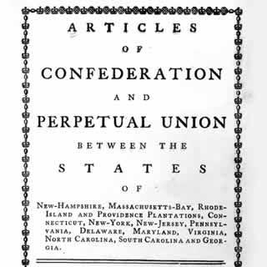
Articles of Confederation
1776 – 1789
America’s first constitution, but not the same as we have today
Provided a very WEAK central government
Due to experience Britain’s monarchy, so their goal was to give as much power as they could to the people through “autonomy” of the states.
Too many limitations caused the government not to function smoothly

Slide 26
National Government’s
Powers
Did not have Power
Declare War
Coin Money
Establish post offices
Send and recall Ambassadors
Could not impose tax
Could not regulate the trade of goods between the states (states could put taxes on each other)

Slide 27
Lesson Three (SS8H4a) – The student will analyze the strengths and weaknesses of both the Georgia Constitution of 1777 and the Articles of Confederation and explain how weakness in the Articles of Confederation led to a need to revise the Articles.
The Articles of Confederation:
STRENGTHS
1.The Articles of Confederation were written down.
2.The Articles of Confederation set up a representative form of government in which the representatives were elected by the
citizens.

Slide 28
Lesson Three (SS8H4a) – The student will analyze the strengths and weaknesses of both the Georgia Constitution of 1777 and the Articles of Confederation and explain how weakness in the Articles of Confederation led to a need to revise the Articles.
The Articles of Confederation:
WEAKNESSES
The Articles of Confederation only a created a legislative branch!!!
Congress could not levy taxes, leaving the country unable to pay debts or soldiers.
Congress could not regulate trade between the states, allowing trade wars to arise between the various states.

Slide 29
Lesson Three (SS8H4a) – The student will analyze the strengths and weaknesses of both the Georgia Constitution of 1777 and the Articles of Confederation and explain how weakness in the Articles of Confederation led to a need to revise the Articles.
The Articles of Confederation:
WEAKNESSES
Congress could make laws, but had not executive ability to enforce them.
Under the Articles of Confederation, all decisions required the approval of 100% of the states.
Under the Articles of Confederation, all states received only one vote in Congress, regardless of the state’s size (ex., Rhode Island had as much say as New York!!!).

Slide 30
Lesson Three (SS8H4a) – The student will analyze the strengths and weaknesses of both the Georgia Constitution of 1777 and the Articles of Confederation and explain how weakness in the Articles of Confederation led to a need to revise the Articles.
The Articles of Confederation:
WEAKNESSES
7. Congress could not raise an army without the states’ permission, leaving the nation defenseless.
The inability of Congress to respond to Shay’s Rebellion in 1786 threatened the safety of Massachusetts and demonstrated that the Articles of Confederation were unable to perform the most basic task of government…
…defense!!!!

Slide 31
Lesson Three (SS8H4a) – The student will analyze the strengths and weaknesses of both the Georgia Constitution of 1777 and the Articles of Confederation and explain how weakness in the Articles of Confederation led to a need to revise the Articles.
The Articles of Confederation:
SOMETHING HAD TO BE DONE!!!
* Even George Washington, who normally kept his political opinions private, argued that the nation could not long survive under the Articles of Confederation.
Video

Slide 32
Overall Weakness of the AOC
Strong legislative branch
No Executive branch
No Judicial branch
Each state had its own currency
All 13 states had to approve a law for it to pass
ONE vote per state no matter the size of the population
Video

Slide 33
QUICK QUIZ!
The Articles of Confederation

Slide 34
Under the Articles of Confederation, a President would lead the country.
Think
About
It
1
❑ True
❑ False
✓

Slide 35
Under the Articles of Confederation, states would be independent.
Think
About
It
2
✓
❑ True
❑ False

Slide 36
The Articles of Confederation were easy to change.
Think
About
It
3
❑ True
❑ False
✓

Slide 37
Under the Articles, states with more people got more votes in Congress.
Think
About
It
4
❑ True
❑ False
✓

Slide 38
Under the Articles, Congress did not have the power to collect taxes.
Think
About
It
5
✓
❑ True
❑ False

Slide 39
Under the Articles, Congress could pass laws and force states to follow them.
Think
About
It
6
❑ True
❑ False
✓

Slide 40
The Articles of Confederation created the first American government.
Think
About
It
7
✓
❑ True
❑ False

